Slide 1
THE FUTURE OF RANGATAHI SPORT IN NZ AND THE WELLINGTON REGION
NOVEMBER 2022

Slide 2
Background information
Key insights from the qualitative and quantitative research
Qualitative research findings
Quantitative summary
National level quantitative findings
Wellington region quantitative findings
Focus on the key sports
01
02
03
Content
04
05
06
07

Slide 3
01
BACKGROUND INFORMATION

Slide 4
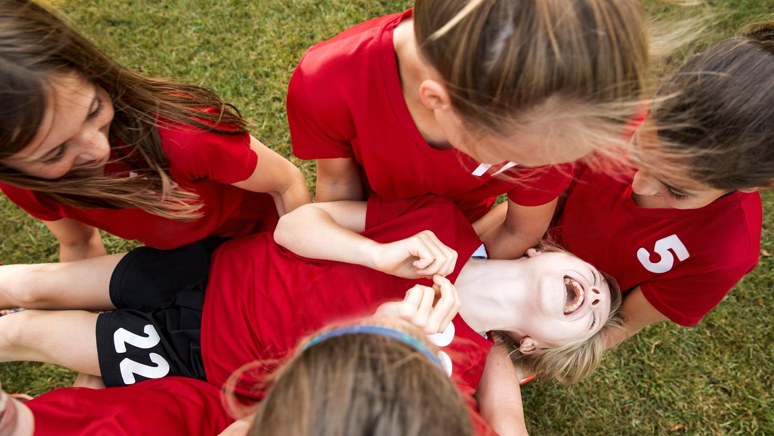
Background
Research was conducted to firstly identify the different barriers and drivers to participating in organised sport, and then secondly, understand the level of impact each of the barriers and drivers has on participation.
The overall goal is to increase rangatahi participation rates in sport.

Slide 5
The research was conducted in two stages; an initial qualitative stage followed by a second quantitative phase. Insights from both stages are presented in this report.
STAGE 1. QUALITATIVE
4 x online Zoom groups
Group format:
Chatting with rangatahi aged 15 – 18 who no longer play organised sport
16 respondents
Focus on:
An in depth exploration of the drivers and barriers to playing organised sport
STAGE 2. QUANTITATIVE SURVEY
Focus on:
Validating the different drivers and barriers to participation in organised sport among rangatahi aged 15 – 18
MAIN FOCUS OF
THIS REPORT
Two sources of respondents:
1) National survey of rangatahi sourced from online panels
1) Survey of rangatahi within the Wellington region sourced through Nuku Ora’s Regional Sports Organisations (RSOs)

Slide 6
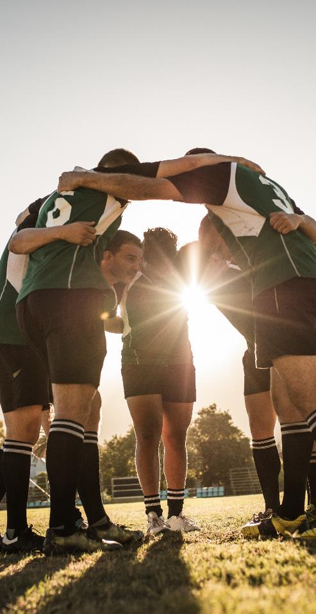
QUANTITATIVE SURVEY SAMPLE SOURCE AND APPROACH Two methods were used to achieve both a national and a Wellington region sample:
1
National survey:
A survey link was sent to potential parents of rangatahi inviting their teenager to participate in the survey. If the rangatahi qualified and completed the survey the parent received our standard incentive, and the teenager was entered into a prize draw. The national survey sample was sourced from Kantar’s online survey panels.
2
Wellington regional survey:
Kantar Public (through Nuku Ora) asked nine RSOs to send a survey invite to rangatahi on their database. Of these, five RSOs sent the invite and had rangatahi complete the survey (Capital Basketball; Capital Football; College Sport Wellington; Tennis Central; Wellington Hockey Association).
Research was conducted to understand the level of impact of the different barriers and drivers to participating in organised sport which were identified in the qualitative research. The overall goal is to increase rangatahi participation rates in sport.
Both groups of rangatahi answered the same survey.
There were:
401 online responses for the national survey
335 online responses for the Wellington region survey
Fieldwork:
Monday 12th September to Monday 17th October 2022
Survey duration:
9 minutes
NOTES TO THE READER
Any differences reported in this research are significant at the 95% confidence level, unless otherwise stated. This means we are 95% confident the difference is genuine, rather than a chance result that can occur from surveying a sample of the population.
Individual percentages do not always sum to the ‘nett percentages’ or to 100%. This is due to rounding or because people were able to give more than one answer to some questions.

Slide 7
Further information on the quantitative report
1
National survey:
401 rangatahi who currently play organised sport or have lapsed from organised sport, sourced from online panels.
These rangatahi are referred to as ‘all rangatahi’ or from the ‘national survey’. Please note they are not representative of all rangatahi in New Zealand but are weighted to reflect all Rangatahi who currently play organised sport or have lapsed from organised sport. The results from this survey are the best way to understand rangatahi participation in organised sport in New Zealand and the barriers that influence them from not playing.
2
Wellington region survey:
335 rangatahi sourced through certain RSOs in the Wellington region.
These rangatahi are referred to as ‘rangatahi in the Wellington region’. Please note they are not representative of all rangatahi in Wellington region (and they are not representative of all Rangatahi in the Wellington region who currently play organised sport or have lapsed from organised sport either). Instead, they reflect the RSOs through which they were recruited and there will be a bias in the results based on which RSOs did/didn’t participate in the research and the number of respondents for those that did. For example, there will be a bias for current/lapsed hockey players due to the number of respondents sourced through that RSO. Therefore, caution should be taken when interpreting the results of the Wellington region survey. Results are unweighted due to an absence of targets to weight to. RSOs that had rangatahi participate in the Wellington region survey:
The survey findings are split into three sections:
RSO | Number of rangatahi respondents for particular RSO
Capital Basketball | 32
Capital Football | 47
College Sport Wellington | 106
Tennis Central | 26
Wellington Hockey Association | 124
3
Focus on the key sports:
This section combines national survey data with that for the Wellington RSOs (736 rangatahi in total) in order to have a sufficient base to analyse the key sports separately (=>30 base sizes). The results are unweighted. Caution should be taken when interpreting the results as data is not representative of all those who participate / did participate that sport across all New Zealand, instead, there will be a bias towards the Wellington region for sports where the RSOs supported the survey.

Slide 8
02
KEY INSIGHTS FROM THE QUALITATIVE AND QUANTITATIVE RESEARCH

Slide 9
To summarise the research findings, what lapsed rangatahi want to feel is...
FUN
CONNECTION
PROGRESSION
&
FLEXIBILITY
The pressure to perform for rangatahi increases as they get older.
They want to enjoy themselves, hang out with their team mates and emulate their sporting heroes.
They want supportive encouragement from adults on the side-lines.
35% of rangatahi associate ‘fun’ with sport in general.
Spending time with friends, meeting new people, connecting with their whānau.
35% of rangatahi associate ‘teamwork’ with sport in general. Other key associations are ‘friendships’ (24%) and ‘socialising’ (20%).
Rangatahi want to feel a sense of accomplishment. This involves improving their skills, getting fitter, celebrating personal progress, and receiving acknowledgement from their coach.
While the team is important, this element is about the individual! And differs from rangatahi-to-rangatahi.
Some key ideas from rangatahi include:
Shorter games,
Allowing greater flexibility for participation in games / training,
Providing equipment at games (so rangatahi don’t need to buy / carry this)
More social leagues.
The most important things getting in their way are…
Needing to turn up to every game/session
Everything else!
COVID was too disruptive
Time of day for training
Friends didn’t play
46% of lapsed rangatahi said they had too much other stuff going on
29% of lapsed rangatahi mentioned this
28% of lapsed rangatahi mentioned this
27% of lapsed rangatahi mentioned this
27% of lapsed rangatahi mentioned this
Other opportunities for fun, progression, and growth become available as rangatahi get older:
Hanging out with friends, wanting to sleep in, influence of peers/friends.
Non negotiable activities eat up time including school and work.
Other, flexible activities that require less commitment, e.g., skating with mates, gaming, other interests.
55% of rangatahi think more social leagues, with emphasis on participating and having fun would be effective in encouraging young people to continue with organised sport.
45% of rangatahi think more flexible teams, with less commitment, would encourage young people to continue with organised sport.
Once young people stop playing, it’s tough to get them moving again: motivation dwindles, they’re out of the routine, any performance anxiety is increased.
They’re looking for external motivation to get back into it.
The preferred times for training are:
Weekdays – soon after school (59% of rangatahi prefer)
Weekdays – in the evening (28%).
This does differ slightly by age, with younger rangatahi preferring the earlier time slot (65% versus 54% for rangatahi aged 17 – 18).
Having fun and team bonding is important for rangatahi, so they feel connected to the team.
60% of rangatahi have continued playing with their current sport because ‘it’s fun’, and 47% because their ‘friends play, or they like their team-mates’.

Slide 10
03
QUALITATIVE RESEARCH FINDINGS

Slide 11
Initially, rangatahi get into sport because of the sport itself. This is often encouraged by a parent, teacher or close friends.
What they want to feel is...
FUN
CONNECTION
PROGRESSION
For those who are dropping out, the actual sport itself becomes a less central part of the experience.
&
FLEXIBILITY

Slide 12
Sport becomes the vehicle to experience fun, connection and growth
WHY FIRST GET INVOLVED?
It's about the sport. For most, there is little expectation to achieve.
It's about fun and hanging out with friends/teammates.
It's about emulating your heroes, your family. Often these are well known, traditional sports (such as netball, rugby).
AT AROUND 15 YEARS OLD, THINGS CHANGE
Expectation to achieve increases. There is a certain level of 'commitment' required.
There is both internal pressure (I can't let the team down), and external pressure (parents and coaches expectations increase).
Early starts and increased trainings.
Sport gets more serious - outward pressure to perform and win.
But the rangatahi we spoke to still want fun, progression and team bonding. But this gets lost in the pressure to compete and succeed.
Those who do well and want to compete and explore professional pathways are likely to thrive.
Those who value fun over competition feel they have nowhere to go and look for fun and opportunities to connect in other ways.
The opportunity to engage with these young people is in transitioning these kids to other sports, or to sports that emphasise fun and flexibility
e.g ..."This is the sport you can play if you're busy at school and want to have flexibility and fun"

Slide 13
Expectations shift as rangatahi get older, with other activities promoted and sport becomes more serious
When rangatahi are first getting into sport, especially during primary school, there is a lot of encouragement from those around them to give it a go and join a team.
Whether that be from whānau, teachers, or others around them.
School notices are circulated and there are many opportunities to join a team sport.
As you get older and into teenage years, rangatahi are given more independence and freedom to make their own decisions.
However, this does not always work out in favour of organised sport. Some rangatahi suspect that their peers still need to be encouraged to get involved.
Other challenges include increasing competition and skill as you get older, which can be off-putting if you are made to feel out of your depth or comfort zone, or no longer considered the ‘best’.
"You're not really encouraged to do the sport as much either. Like when I was in year nine, we were constantly getting notices, like, you know, come play sports come sign up... [Now], it's more like about clubs and about other stuff, there's not as much promotion around it [sport]… I think that [young] people have got to have a lot more encouragement to actually go out there and do it themselves." Female, 15-16 years, Pākehā
"I stopped playing volleyball because it was a big jump from junior sport to senior sport. It was really hard competing with older girls, and they already had a really great team. It was hard breaking into it." Female, 17-18 years, Pasifika
"I feel like [young] people are a lot more competitive as well. Like if you're not in a good club or the top teams, they're not really like wanting to do that sport anymore because they're not like up there at the top." Female, 17-18 years, Chinese

Slide 14
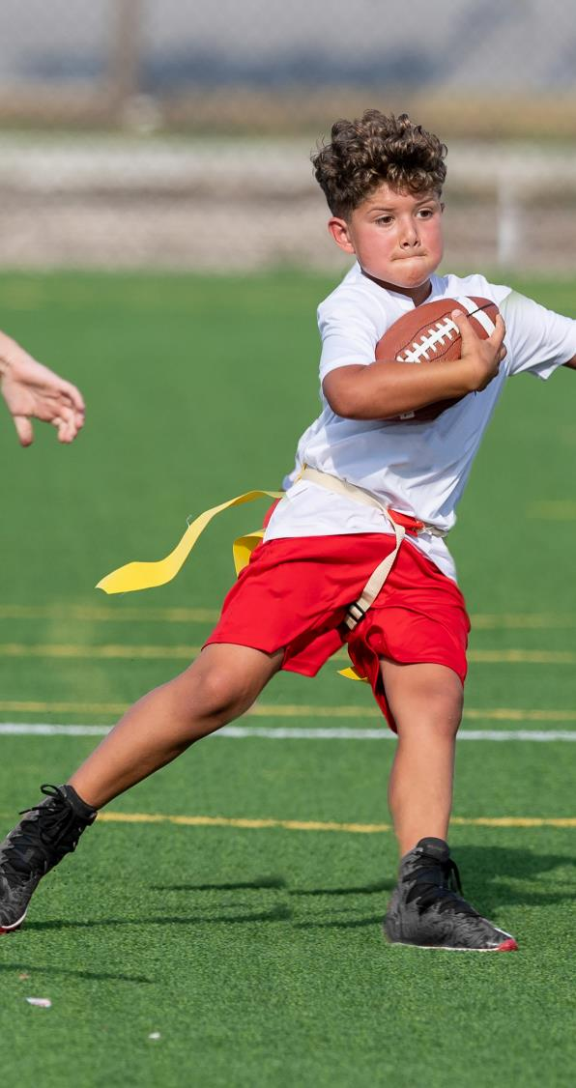
There is a focus on mainstream sports like rugby, netball, football and cricket, with many rangatahi falling into these by default
Other less well-known sports can feel more fun because less is known about them – meaning that there is less pressure to perform.
Parents are unable to exert pressure on these smaller sports e.g. water polo, badminton, ultimate frisbee, because they know less about them.
Playing these sports can also be an expression of individuality. Even when a group of friends all decide to do it together it sets them apart from others.
Some regret not starting other sports in the first place, because they feel the experience is more fun.
There are also gendered expectations when it comes to mainstream sports, which can prevent rangatahi from finding their niche earlier.
"There's not many opportunities to be fair. The big sports are rugby and cricket, with other sports, there's not many other opportunities.” Male, 17-18 years, Indian
“When I think of netball, it's not necessarily good... But then I also played water polo for four years when I was younger and that was like, the best time. We had the best coach and the best training, and it was just such a fun time, it was no stress. But like with [netball], I just think of stress immediately.” Female, 15-16 years, Pākehā
"I started playing netball because every other girl was playing it... I stopped because I felt like I was always the biggest kid there, I was always getting picked on to play defense, and I wasn't as fit as other people... But then I switched to rugby, and it felt great.. I wish I’d tried it sooner." Female, 17-18 years, Pasifika
"I wish I'd tried more of a variety of sports, earlier. I felt like I only stuck to what I knew until year 13, where I branched out and tried some other things, but that was still like ages after I started playing sport, so definitely try more stuff, just because you like one sport doesn't mean you won't like another thing more." Female, 17-18 years, Pākehā

Slide 15
What does growth, fun, and connection look like?

Slide 16
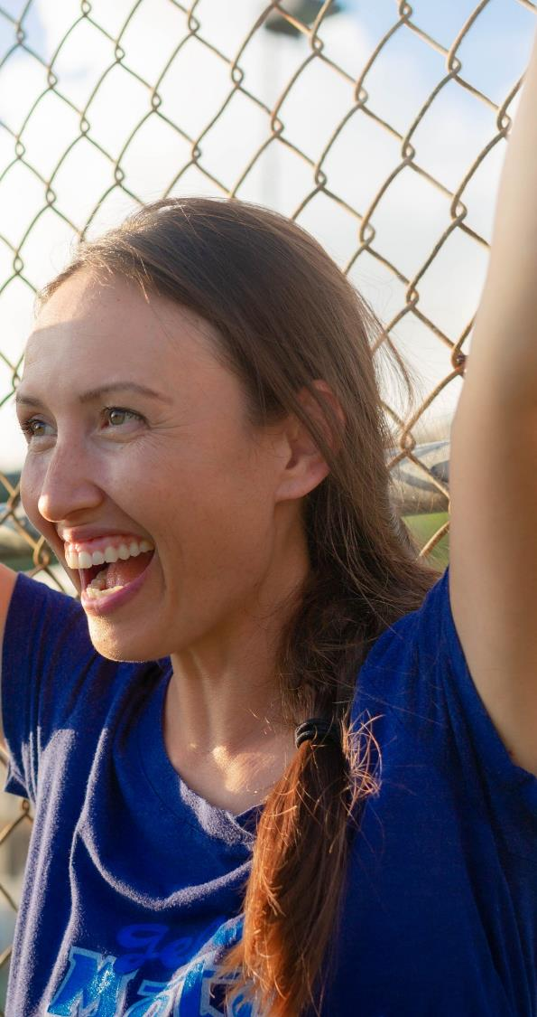
For rangatahi, playing sport is about ...
Almost all the young people we spoke with talk about wanting to feel a sense of progression – a sense of 'getting something out of playing sport'.
While the team element is important, rangatahi think about progression and achievement on an individual basis. What achievement and progression means will vary from person-to-person.
Progression can be about improving skills but can also be as simple as getting fit.
One of the consistent messages rangatahi talked about is wanting to be acknowledged by their coach as an individual, and to feel like their coach understands and works on their individual strengths and weaknesses.
Rangatahi want to feel a sense of achievement. Celebrating the small, personal milestones is important.
This is something they feel is lost from their earlier experiences playing sport.
"Sports are the most fun when you're still learning it. That's why I didn't play sports for very long to be honest. That's when I'm enjoying it the most." Male, 17-18 years, Pākehā
“At our school, if there wasn't enough players in the A Team, they would always want players from the B Team. So, I was always trying to play my best so that the A Team's coaches would see, and I'd always get put into that team to play. And that was like what pushed me to try to try do my best.” Female, 15-16 years, Pākehā
“I wasn’t always in the top team, but I guess in high school I was always looking forward to the games. I hated trainings, but I always looked forward to the games and the adrenaline during the game and everyone complimenting you after if you did great.” Female, 17-18 years, Chinese
“When I was younger, this is going to sound stupid, but [I used to look forward to] player of the day. You got a little voucher, so I was always trying to push to get it. When I got it [player of the day], it just made me enjoy it even more.” Female, 15-16 years, Pākehā

Slide 17
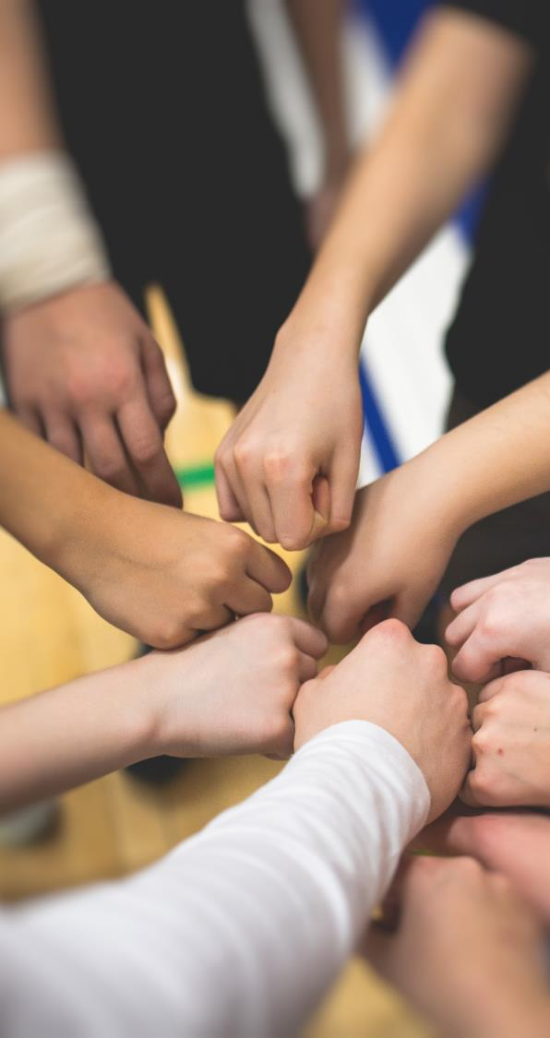
For rangatahi, playing sport is about ...
This is about spending time with friends or building relationships with teammates.
But it can also be about connecting with whānau, or the people around them through a shared appreciation of sports.
Many rangatahi join sports teams to make friends and social connections. If this element is missing, the sport quickly becomes a way to pass time, and interest in the activity fades.
Some rangatahi are making their own teams, with friends, if this element is missing from their current experience.
However the drive to make their own team based on friendships is the exception – many will drop out completely and won't take the initiative to form their own team if a sense of connection is missing.
Rangatahi enjoy opportunities to bond together with their team, whether that be turning up to games together, after-game celebrations or making time to hang out together outside of the sport or before trainings.
"Sport was also time for my parents to come and see me and hang out with me because they worked a lot during the week. But Saturdays were the only day where they were like, 'let's go watch [name redacted] play' and it was our time together... My parents, and aunties and cousins would come and watch me play, they'd bring treats, and my dad would be there to give me tips, which was mostly positive." Female, 17-18 years, Pasifika
“[Badminton] was more about hanging out with my friends and just having fun... Whereas hockey was more competitive, it was different. I didn't know everyone on my team. So, it was kind of just a thing in my week that I went to.” Female, 17-18 years, Chinese
"I stopped playing soccer and started playing water polo. All my mates decided we would make a team. We didn't really care so much about the sport, it was just so we could hang out" Male, 17-18 years, Māori/Pākehā
"I'd want more social events with the team. There's always an end of year thing, but an after-game celebration would be good, so we can bond as a team." Male, 17-18 years, Indian

Slide 18
For rangatahi, playing sport is about ...
Sport in the early years is all about having fun and working together as a team. There is little expectation (inwardly and outwardly) of anything but having fun.
As rangatahi get older, this changes. This sense of fun is lost, as pressure to perform increases.
Talented rangatahi are expected to pursue professional pathways, which is not always the pathway they want to take.
To find the joy and fun in sport again, rangatahi look for other activities to engage in with their friends, e.g. social leagues, badminton, skateboarding.
"We stopped playing water polo because we started playing teams who were heaps better than us and we were getting thrashed. It felt like there was pressure to perform better." Male, 17-18 years, Māori/Pākehā
"I think what sport is all about it being able to have fun and having something that you really enjoy. Being able to do it with friends and your team and sharing the experiences with them. It can be really rewarding, and it make you feel good." Female, 15-16 years, Pākehā
"I feel like I only got the motivation for competitiveness as I got older. At the start I think it was about hanging out with my friends. Having fun with everyone because I hated doing nothing. So, it was filling in the time, doing fun things instead of just sitting around at home." Female, 17-18 years, Pākehā

Slide 19
"My [younger] sister had hockey trials last year as well, but she decided not to go to them and just went to hang out with her friends instead. So, I guess, just making more time for like other things that matter to us.
"I joined [hockey] quite late. So, my coach was quite hard on me trying to get me at the same level as the other girls, who had already made a connection with each other as well. I was left out a bit. So that's probably what really put me off of it in the end." Lily Female, 17-18 years, Māori/Pākehā
"Organised sport is such a great way to make friends and like learn social skills. Not only are you active but you also learn how to prioritise your time, making sure that you're turning up to training on time. I think it teaches young people a lot." Female, 17-18 years, Pasifika
"When I first started playing rugby, I was the youngest and the newbie. I didn't have much pressure to be great, and if I did something above average, everyone would mention it and I'd feel great. When I finished playing rugby, I was the oldest and the biggest on the team. I felt really old and felt a lot of pressure to tell the newer players what to do and I felt like I shouldn't be mucking around that much. I also compared myself to them because they were so much better than I was at their age. I wish I could've kept playing at the same level that I started at." Female, 17-18 years, Pasifika
I'm really grateful that like, what my parents did was they like, really pushed me into them at the beginning. But if I wasn't having a good time, like let me quit. Because like, obviously, there's some, like circumstances that like you need to like, keep pushing forward and like not just quit straight away. But I'm just much happier with them, like letting me just like stop when I need to stop but like pushing me into like a new thing straightaway. So I was never just doing nothing. Female, 17-18 years, Pākehā
“As you grow up, you start to think 'oh, I could be going to hang out with my friends', 'if my friend doesn't play netball, I don't want to play anymore either, because then I can't see her'. Then you end up skipping trainings and [playing sport] is kind of a waste of time, if you don't actually turn up." Female, 15-16 years, Pākehā

Slide 20
What's getting in the way of young people wanting to continue
playing sport?

Slide 21
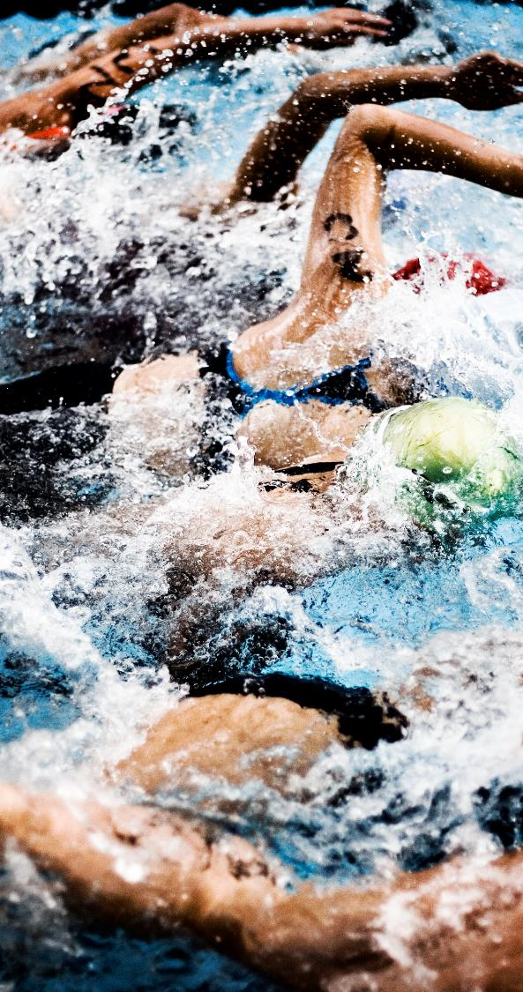
Many rangatahi experience pressure to perform that leads to a sense of overwhelm.
Many rangatahi feel that they aren't good enough. This come both from external pressure (coaches and parents) and internal pressure. ​
This fear of judgment usually centers around...​
1. Being humiliated or embarrassed. ​
Doing something wrong in front of others that would cause embarrassment. This is often caused by having high standards placed on them, and a fear of failing to meet those standards​.
​
2. Letting the team down. ​
By simply not being good enough. Low perception of competence, or not feeling physically fit enough. ​
This pressure means that some rangatahi spend time looking at videos and doing extra work out of fear they are not good enough.
Often this pressure, combined with pressure to perform in other areas such as school, becomes too much.
The overwhelm is a bit of fear, like there are too many things going on at once. You might be thinking, 'what am I going to do during the game, how am I going to react if they do this thing.’ Male, 17-18 years, Pākehā
Sometimes you’re expected to win, and you think, what if I do something wrong, that will be so embarrassing. Male, 17-18 years, Indian
I usually have to force myself to try and have positive thoughts and self talk. Because usually I have negative thoughts and I don't have self-belief.’ Male, 15-16 years, Pākehā
“After you make a mistake, you’re self-conscious for your next few games. You’re worrying about if you’re going to make a mistake again or scared you or someone else is going to be yelled at. It just makes you feel quite crappy, and you don’t enjoy the sport as much.” Female, 17-18 years, Chinese
For me it's the fear of holding back the team. I put it on myself... Male, 15-16 years, Pasifika

Slide 22
Negative criticism from both parents and coaches is a major cause of young people turning away from sport
Young people crave and thrive on constructive feedback. It helps them to get better and to develop the sense that they are achieving something.
​
However, there is a fine line between constructive feedback and criticism.
Constructive feedback is...​
Framed positively​
Helpful and supportive, rather than to vent frustration or to berate ​
Toward the individual as well as the team.​
Negative criticism carries with it a great sense of failure and of shame that rangatahi carry with them. Often a way to avoid carrying that shame is to drop out.
Your coach says you played a really good game, then you're on your way home, and get all these really negative comments about how you played. It's kind of hard because you hear positive things from somebody, then you get negative things from someone else. It makes you think 'Am I doing well, or am I just..." Male, 15-16 years, Pasifika
“If you’ve got a team that’s really supportive but gives pointers in a genuine way that helps a lot, rather than [your teammates] screaming at you, which makes you self-conscious and you can get worked up about your game.” Female, 15-16 years, Pākehā
“A lot of the time the parents [of my teammates] were also hockey players. Sometimes I’d get a ride home from my good friend after games, but her dad would just be yelling at her, being like ‘why did you do this, or ‘why didn’t you run for the ball here’. [In my ideal world] parents would be just happy for what their children did and proud of what they’ve accomplished.” Female, 17-18 years, Chinese

Slide 23
What do young people want in a coach?
A mentor – someone who connects with players and understands the individual.
Someone who has a passion for the sport.
Someone who is personally invested – they want to be there; they show up to training on time.
They are positive and give constructive feedback to get the best out of people.
Understands players strengths and weaknesses and help to work with these.
Doesn’t pick favourites, invests in the whole team.
"The coaches should be more actively social, because they seemed quite hard to talk to. It's hard to approach them. It would really help if they were more approachable in one-on-one situations" Male, 17-18 years, Pākehā
"I would want a good coach that accepts everyone and doesn’t put anyone down. They would help people train with their strengths and knows everyone’s weaknesses so they could work around them. They wouldn’t put anyone down because they can’t do something, overall having an accepting team. Not pushing people too hard during trainings. It should be hard, but not exhausting." Female, 15-16 years, Pākehā
"My old coach would tell us to run laps, [trainings] weren't actually about the sport... [The coach] wasn't trained to play the sport and … [they] put us to the side because we weren't the top team. I think coaches needs to be experienced in the sport. If you've just got like a good coach who knows what they're doing and is more focused on actually learning how to play the game." Female, 15-16 years, Pākehā
"[The coach] never talked about people's sizes or had any favorites, even though his daughter played in the team. He gave everyone equal time on the field, and he made the sport approachable for me too, because it was my first year [playing rugby] and I didn't know what to do, which was comforting." Female, 17-18 years, Pasifika

Slide 24
What do young people want from a supporter?
They want positive reinforcement and support – both cheering from the side-lines (positive only) and positive support after the game 'you did well today'.
Providing practical support – buying equipment and transport to the games.
Giving encouragement and motivation to keep going with the sport.
Understand the intention of the game, that it isn’t always about winning.
Rangatahi don't want their game critiqued or to hear advice on how to play the game – particularly if this conflicts with what is being said by the coach.
"Parents should be there, not to force us to play, but encourage us to do it... I remember my dad didn't want me to do any sports because of the cost, but my mum wanted me to build team bonding skills. But yeah, it would've been nice to just get encouragement from them... Showing us what each sport is really about as well, seeing what you can learn from it." Female, 17-18 years, Chinese
"My whole family was so supportive, even my grandparents would come and watch me play football, I loved it. But my mum used to try to be the coach of every single team I played on or try be involved [in other ways]. I used to be a bit of brat about it... and wish she'd just be on the side-lines, like all the other parents, but at the same time, when I look back at it now, I appreciate it so much." Female, 17-18 years, Pākehā
"It felt great having my whole family watching me play, but then also, it was a lot of pressure. Especially when you're young and I felt like I'd actually have to play properly before my dad like told me off for messing around. But I liked seeing how everyone reacted when I got a shot, that was a great feeling." Female, 17-18 years, Pasifika
"When the coaches tell you play good, and then you jump in the car with your dad, it's like a whole new level of disrespect. You get told off for no reason. Like you missed one tackle, and you cop it." Male, 15-16 years, Māori

Slide 25
Many rangatahi talk about simply becoming bored.
This is caused by a sense of prioritising repetition over progression
Many of the young people spoke about leaving sports because it had become 'boring’.
This is often from a sense of repetition and feeling like they are being taken through the motions, rather than growing and progressing.
One rangatahi remembers enjoying when the team were able to instead choose the training activities, which kept it interesting and useful.
“Getting bored was the big reason I stopped playing to be honest. I just got bored, it was all the same and it wasn’t interesting anymore. It was doing the same thing at training every week." Male, 17-18 years, Pākehā
I started off enjoying it, then it was the same thing twice a week. It just got too repetitive." Male, 17-18, Pākehā
"For me I'd like to change up how the game is played a bit, trying to form a different attack, or trying a different strategy more often. Male, 17-18 years, Pākehā
"With football trainings, I'd find them really boring, just because you're not really getting much pleasure out of it. You don't really win or lose, you're just in that middle ground the whole time. I always loved when coaches would ask us what we wanted to do... We want to improve our skills and from there, we'd have the motivation to do it because we picked it, it's different from being forced to do something in that way." Female, 17-18 years, Pākehā

Slide 26
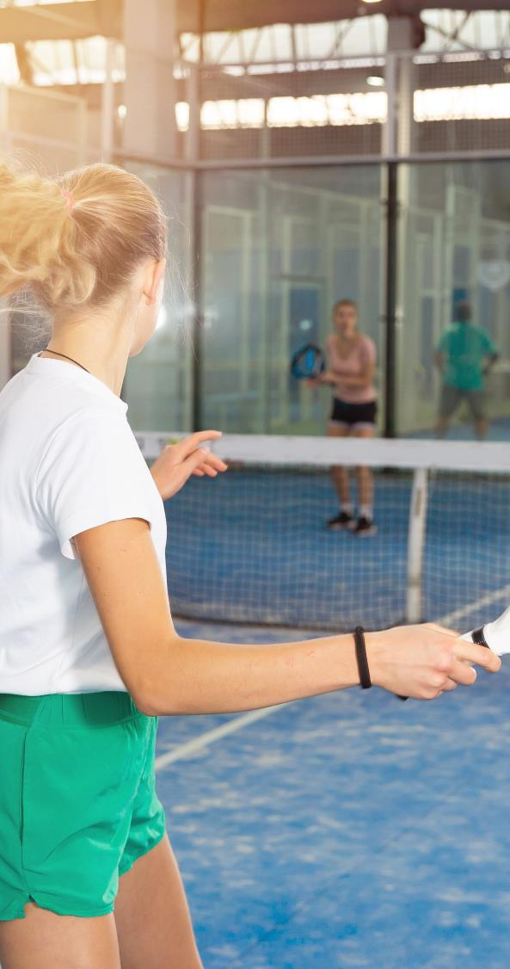
A perceived lack of fairness can take away the enjoyment of playing
Young people have an acute sense of fairness. This was especially a barrier amongst young girls.
Seeing others being chosen for the top teams or are given playing time because they have connections to the coach (often either a parent or teacher), rather than their skills, lead to a loss of motivation.
Some talk about referees being deliberately one-sided, and that taking away the enjoyment of the game.
"I was playing at a pretty high level, and I was on the side-lines a lot, so I just wasn't really keen to keep going I guess." Male, 15-16 years, Pākehā
“When I was younger, the teacher [who was also the netball coach] was friends with all of the kids’ parents, so she was influenced to pick their children [for the team]. If you didn’t have that, it would be a completely different team, picked for their skill level and not because of their parents… It would be a lot more equal and enjoyable that way.” Female, 15-16 years, Pākehā
“There was a lot of sort of favouritism around the [coach’s] child and their child's close friends, as well. The parents didn't really care about anyone else's children. So, [my ideal] would definitely be the parent [coach] treating everyone equally. And by not like, putting, like, their own kids and their kids was like, closest on.”
"I see it in trials as well, when [coaches] will pick and choose who they want based on looks, wealth and all that. I’d like to see coaches making sure that everyone there is equal. Actually, based off your skills rather than other things." Female, 17-18 years, Chinese

Slide 27
For many, after COVID lockdowns, the motivation to get back into sport just isn't there. Once young people stop playing sport, it's hard to start again.
Many young people openly admit that they become lazy and unmotivated – once they get into the 'mode' of playing video games and watching Netflix, motivation to play sport dwindles.
Once they get out of the routine, the pressure on some young people around performing increases. Any fears they have are increased.
They look for external motivation from schools and elsewhere to encourage them back into it.
"[Coming out of lockdown] because it was the first time seeing anyone in six weeks, I got a bit of social anxiety. I was worried that people might think I looked different, because you got so comfortable sitting in your room every day for like, over a month." Female, 15-16 years, Pākehā
"Going into lockdown, then coming out, after so many months, it's hard to get back into the swing of things. People lose motivation. I feel like being lazy. With COVID, everyone got lazier, " Male, 17-18 years, Pākehā
"With COVID as well a lot of people started working out at home, figuring out they'd rather go to the gym and be alone working out than exercising with other people." Female, 17-18 years, Chinese
"Being in lockdown, people got kind of comfortable with it, and then didn't really have much motivation to get out and get into it [sport] again. Getting into a sport where you have to run around and be really active and fit is hard to do. As soon as you get out of that, the cycle of doing it every day, every week, it gets so much harder to get back into it and to get the motivation with it again. COVID definitely had the biggest impact on it." Female, 15 - 16 years, Pākehā
“COVID was a big factor of me not doing hockey anymore was because I didn't know how many games I was going to play and I didn't want to pay [the fees] just to play like a few games." Female, 17-18 years, Chinese

Slide 28
There are also practical considerations that young people mention that get in the way...
Playing outdoor sports in all weather was off-putting for some rangatahi, especially when uniform requirements were prioritised over their wellbeing.
Games and trainings being too far to travel to, especially without reliable transport options.
Trainings being too early in the morning before school, then impacting the rest of the day, as well as the night before.
Having to bring too much equipment to the game, or to school beforehand.
Ongoing and increasing fees, including registration and uniform costs, which rangatahi notice impact who is able to continue playing sports.
"I hated playing football in bad weather. If you're an attacker or in midfield, you're running around, but whenever I'd play goalie or defense, you're just standing there in the pouring wet. I used to get told off for wearing a hoodie because it wasn't part of the uniform." Female, 17-18 years, Pākehā
"I went to a fees-free primary school, all the kids were playing all these sports, basketball, rugby, touch. Once I hit college, it was like $300 per term. On top of that, I would always need new shoes every single season and it would just add up. I don't know why there are so many fees." Female, 17-18 years, Pasifika
"It would be nice to see more diversity amongst sport... In certain sports, and definitely rowing, because it's such an expensive sport, there are a lot of rich, white girls and boys. I think that stereotype needs to be broken, because it can get really toxic and make people feel left out... Some people play into that stereotype and think they're better than everyone else because they had to pay $50k for a boat." Female, 15-16 years, Pākehā

Slide 29
Uniforms were a huge issue amongst young girls, who felt that their looks were often prioritised over their comfort or performance
There have been changes in recent years allowing more choice for general school uniforms, however, it seems this flexibility has not yet transferred to sports uniforms.
Rangatahi acknowledge that uniforms can play an important role in distinguishing the teams, however, they feel there should be more choice in what they can play in.
Having one uniform style can cause some rangatahi to feel uncomfortable, which can distract them from putting their all into the game, e.g. short skirts that don’t cater to all body types.
Not only can the styles be physically uncomfortable, but they can fear judgement from other teammates or supporters on the side-lines about their appearance.
For young girls, it is hard to ignore when observing how boys teams and uniforms are typically more relaxed with a baggy fit, in comparison to their tighter, shorter styles.
"In hockey, we had to have our hair slicked back and always had to wear short skirts. I'm quite tall, so running around the field, instead of focusing on the game, I had to focus on keeping my skirt down. You want to be able to focus and be 100% in the game, but you can't because you're just worried about that." Female, 17-18 years, Pākehā
"I really hate the idea of playing sports in dresses, I have thighs that touch so they give me chaffing. I feel like with volleyball, the girls’ tops and bottoms are always really tight and small, but guys are allowed to wear baggy shorts and t-shirts. Girls always seem to have to look good and look made up, even though they're playing sport." Female, 17-18 years, Pasifika
"With uniforms, obviously, you need to be able to distinguish between the two teams, but I'd rather not having something that you have to wear. Teams could pick a colour instead of a set uniform. That's often what's really annoyed me. I've never really understood why netball players wear dresses, because dresses are so inconvenient to play sport in." Female, 17-18 years, Pākehā

Slide 30
What other activities compete with playing sport?

Slide 31
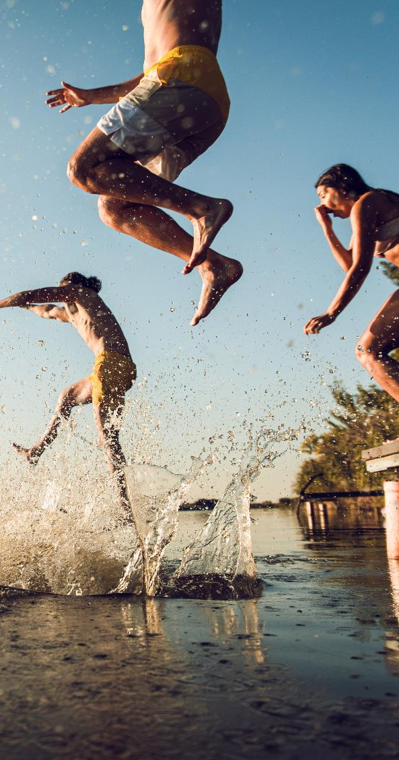
This is the time in life in which other outlets for fun, connection and growth become available to young people
Hanging out with friends at times that compete with trainings and games become more of a priority e.g., after school, weekends.
Rangatahi want to sleep in, as opposed to waking up early to go to trainings, as well as staying up late, going to parties or other social gatherings.
The influence of friends and peer pressure also starts to impact motivation to play sports.
With friends leaving sport, the fear of missing out sets in, and rangatahi would rather prioritise hanging out with friends than turning up to trainings or trials.
"I think a huge thing when you're young is not missing out on experiences with your friends. You want to make the most about being a teenager before you go off into your adult life. You don't want to miss out on making memories or going to events because of sports." Female, 17-18 years, Pākehā
“As you grow up, you start to think 'oh, I could be going to hang out with my friends', 'if my friend doesn't play netball, I don't want to play anymore either, because then I can't see her'. Then you end up skipping trainings and [playing sport] is kind of a waste of time, if you don't actually turn up." Female, 15-16 years, Pākehā
"When you get to your teenage years, friends and boyfriends become more important. It starts to feel like the world's going to end if you're not doing this new trend. So, people decide to stop doing sports... Being a teenager, there's sort of an expectation of how to be and what to do and what not to do. Lots of people just kind of grow out of the sport, or they want to do different things." Female, 15-16 years, Pākehā
"I think our friends have such a big influence on us and we obviously care what they think. So, if you have friends in your team who can encourage you, then that really helps or even if they're not in your team and they just encourage or support you. A lot of the time it's easier to listen to friends than your parents. I think friends have a really big impact on what we do." Female, 15-16 years, Pākehā

Slide 32
Other activities that compete with organised sport
1
2
3
NON-NEGOTIABLE ACTIVITIES
ACTIVITIES WITH FLEXIBILITY THAT FIT AROUND OTHER COMMITMENTS
NOVEL AND NICHE ACTIVITIES
School, part-time work.
Activities that are short, less frequent, or have less need to commit.
Recreation sports e.g. skating.
Pursing other interests and learning other skills.
Lighting production, learning a language.
School work and part-time work usually take priority.
Rangatahi will drift to extra curricular activities that require less commitment. The rigidity of training and game day is turning some rangatahi to other options.
Rangatahi often start engaging in more niche activities that provide stimulation and don't feel 'repetitive’.
"Hockey training was always at 7am on a Monday which I hated. The games would always be Tuesday, Wednesday and/or Thursday all around the Wellington region afterschool... Afterschool worked well at first but after doing exams, NCEA, it all kind of got a bit busy and tiring, waking up early just for trainings." Female, 17-18 years, Chinese
"COVID definitely impacted why I stopped playing sport, I kind of just finished rowing at the end of the season. But also, I was just getting into NCEA. I was also dealing with a lot of mental health struggles, and I didn't want to have to juggle my mental health, school, exams, rowing, friends, boyfriend, parents all at once. So, I stopped rowing. I always said, I might go back to it, but I don't think I will." Female, 15-16 years, Pākehā
"If you do these things might be able to showcase your skills, show people what you've learnt." Male, 15-16 years, Pasifika

Slide 33
Finances and thinking ahead to the future start to appear on the radar for rangatahi
While there is an appreciation amongst rangatahi about the benefits of sport, as they get older, money becomes more of a priority.
As rangatahi are planning ahead for their futures post high school, CV and job prospects are on their mind.
Is there an opportunity to turn organised sport into a leadership opportunity/way to incorporate sport into your CV?
The practical element of sharing time and energy makes it difficult for rangatahi to balance sport, with part-time work, schoolwork, hanging out with friends and finding time for themselves.
"Playing sports is great for the hauora, but it doesn't look as good on a CV as volunteering or doing another job or extra-curricular, like being in a leadership position. If I know that something is better for my time, if there's an option that I'll get better opportunities because of it I'll choose that over playing a game of netball." Female, 17-18 years, Pasifika
"I'd always work on a Saturday. I wanted to play netball with my friends socially, but I couldn't because I worked on a Saturday. So, it really restricts me from a few sports. Sometimes I'd have to work Sunday as well, but I'd also have [hockey] training at 7am on Monday. It felt like a never-ending cycle sometimes, playing sport and also working." Female, 17-18 years, Chinese
"I work one day after school and one weekend day. So, I feel like I actually don't have time to play a sport, because I've also got studying on top of that too... I feel like I also need time to relax and kind of disconnect from school as well because you're there most days... If I didn't have a job, I'd probably do a sport." Female, 15-16 years, Pākehā
"I found it really hard once I started working because I would either let my boss down or my coach. It's like a lose-lose kind of situation. Working becomes a bigger thing because money becomes more of a priority. So, like, sports is kind of like pushed to the back of your head.." Female, 17-18 years, Pākehā

Slide 34
Rangatahi also suspect technology has impacted participation in organised sports
Rangatahi no longer need to connect and hang out physically with their friends, being able to connect via social media from their own homes.
The way that rangatahi think about popularity has also been affected, historically and stereotypically being tied to sports, rangatahi now look to their peer's online presence.
Is sport losing social currency in the digital age?
With the rise of TikTok and other short form media types, rangatahi are interested in keeping up with trends and learning viral dances, more than participating in traditional sport.
"When I started playing sport, I was only doing it to hang up my friends. So, I wasn't just by myself at home. That's been taken away with this generation because they can hang out with their friends on their phones at home [alone]. So, there's not the same want to go and do something because they already have it like right in front of them." Female, 17-18 years, Pākehā
"When we thought about popular kids, we always thought of who was the fastest, and whoever played the most sport was the coolest. But now with social media, it's looking at who has the most followers and that's what we find more important now." Female, 17-18 years, Pasifika
"When I talk to my brothers, I loved playing sport at their age, but they just play games. They compare phones with their friends, they don't talk about sports at all, it's all about what's trending." Female, 17-18 years, Pasifika
"I used to coach a dance team. In the last few years, everyone wanted to come in and learn the TikTok dances and post their videos online." Female, 17-18 years, Pākehā

Slide 35
What do rangatahi want?

Slide 36
The ideal game structure
Not in the morning
Not at lunch time at school – (it increases the pressure)
Parents and whanau watching, but encouragement only from the sidelines
Some flexibility about playing and training
Shorter games
Keep the team level – e.g. all people who are new to the sport in the same team
Equipment is provided at games (or no equipment is needed)
Emphasis on fun and fitness (rather than competition and winning)
More social events
Turning up to the game with your teammates
Training to be interesting and be about getting better
"I haven't played football for a while, but I just filled in for one of my friend's team last weekend. I thought a 90-minute game was so long, because I wasn't used to it and like had done that much exercise in a while. So [my ideal game] would be a bit shorter because it was a bit of a shock to the system... We also had people coming late and leaving early because they had work, which didn't happen when we were younger, but is happening now. So, it would be better to have an hour to slot into your day." Female, 17-18 years, Pākehā
"Everyone getting a ride to the game together so everyone can hype each other up as a team, jamming music, and getting in a good mindset together... When you're alone, turning up you could be overthinking things and getting anxious about not playing well, but when you turn up with your friends, you're focusing on the team." Female, 17-18 years, Pākehā

Slide 37
The ideal team
"Going to games together [as a team] rather than separately is also really good because then you can hype each other up before the game... Afterwards, just bonding and getting to know each other... I've experienced people on teams not liking each other... they didn't pass the ball to each other during the game, which would impact how the game turned out." Female, 17-18 years, Chinese
Rangatahi enjoy turning up to the game with other teammates to combat pre and post game nerves.
They appreciate bonding opportunities with teammates, to gain connection and increase their enjoyment and fun.
Rangatahi value sharing sport experiences with friends, or otherwise befriending teammates.
"I'd want my friends playing with me, as well. So, it doesn't feel as lonely and isolating, not knowing anyone else. Or actually getting to know everyone else when your team already knows each other." Female, 17-18 years, Chinese
"If I was new [to a sport], I'd like to start playing with friends, because it would be a lot more comforting. And if that wasn't the case, making everyone on the team comes to training a bit earlier just to learn about each other beforehand, rather than playing a game with strangers because it's just not as fun but also causes quite a bit more anxiety when you're not sure what's going to happen, and you don't really know who anyone is." Female, 17-18 years, Pākehā

Slide 38
Create opportunities for sport that are flexible and are about fun
More opportunities to trial different types of sports.
Something similar to the social leagues that are available for adults – can we do something similar for rangatahi?
"I feel like it'd be better if the people playing the game, the people doing the trainings and wearing the uniforms had more of say... With trainings as well, I came into the game [hockey] quite late and I was really behind all the other girls, but I got put at the same training level as them and I had like no clue what I was doing." Female, 17-18 years, Pākehā
Is training as we know it redundant?
Prioritise the following:
Progression,
Working with the individual, not the team,
Team bonding, and
Having fun.
Balance parental involvement:
Continuing to educate (or creating rules) for parents on the sidelines.
Creating more autonomy for rangatahi to find alternate ways to get to game.

Slide 39
04
QUANTITATIVE
SUMMARY

Slide 40
Why are rangatahi stopping playing organised sport?
The number one reason is because they’re too busy, but the structure of organised sport is also pushing rangatahi away.
When we quantify the barriers identified in the qualitative research, pressure on their time stands out as the main reason rangatahi have lapsed from a particular organised sport. However, there are a range of reasons that are important in this decision and so to solve the issue of participation a multi-faceted response is required.
The top 10 reasons why rangatahi stopped playing a particular organised sport:
% rated 4 or 5 out of 5, where 5=extremely important
Didn’t enjoy it anymore and it was a lot of hours.”
(Female, lapsed swimming)
“Studies and a part time job take up too much time.”
(Female, lapsed netball)

Slide 41
How do barriers differ by sport played?
There are no significant differences between which barriers are associated with which sports for the national survey.
However, when the results from the national and Wellington region surveys are combined to provide a larger base size for the sports, we can see some barriers are more closely associated with certain sports. These are not necessarily the key barriers for these sports – which are shown on the next slide – but those which are significantly more of an issue.
Caution should be taken when interpretating these results as there will be a bias towards issues in the Wellington region for the RSO sports that participated in the survey. The relative differences are also depicted in the correspondence map on slide 39.
Hockey is more likely than average to be associated with the following barriers:
The cost of taking part.
Worrying they’d do something wrong.
Having to play outdoor sports in all weather conditions.
A lack of fairness or transparency.
Cricket is more likely than average to be associated with the following barriers:
The length of season being too long
Amount of time required for games and training
Doing the same things every week, it’s getting boring.
Netball is more likely than average to be associated a lack of fairness or transparency.
Football is more likely than average to be associated with the following barriers:
Having to play outdoor sports in all weather conditions
Parents/whanau not being supportive or encouraging enough
Needing to turn up to every game and training.

Slide 42
The charts below outline the top barriers for each of the key sports, which do differ on a sport-by-sport basis.
Again, these are based on the combined results from the national and Wellington region surveys to provide a larger base size. Caution should be taken when interpretating these results as there will be a bias towards issues in the Wellington region for the RSO sports that participated in the survey.
% rated 4 or 5 out of 5, where 5=extremely important
Top 5 barriers for football:
Top 5 barriers for basketball:
Top 5 barriers for cricket:
Top barriers for hockey:
Top 5 barriers for netball:
Top barriers for rugby:
Top 5 barriers for tennis:

Slide 43
Apart from overcoming the barriers, what are some of the ways sports can encourage and optimise participation?
It is important to promote the benefits of playing organised sport to all rangatahi. There are many perceived benefits of organised sport that can be promoted. In particular the social aspect comes through strongly, as well an opportunity to progress and develop:
It’s fun (60% of rangatahi participating in organised agree this is a main reason why they play).
I’m good at it (48%).
My friends play or I like my team mates (47%).
My parents/whānau support and encourage me in the right way (33%).
I get to progress/develop (32%).
Rangatahi agree that training should occur on weekdays – either shortly after school finishes (59% agree), or in the evenings (28%).
Having more social leagues, emphasising taking part and having fun rather than winning, is an effective way to encourage young people to continue with organised sport (55% of rangatahi say it would be effective). However, it’s also important to continue offering rangatahi a more competitive alternative.
“Keep a consistent timetable for trainings etc, changing too much can cause people our age to quit cause a lot of us have part time jobs that we can’t keep changing days.”
“Social leagues are a great place to start as there shouldn't be any pressure to win, it’s purely for fun.”
Two thirds of rangatahi say making it easier to play for their club and also their school is an effective way to encourage them to continue playing.
55% of rangatahi say increasing the number of young people who can make development squads is an effective way to encourage them to continue playing.
Rangatahi want positive support from adult supporters at the games. 63% say that less bad or negative behaviour is an effective way to encourage continued participation.
“Advertise and let sport be portrayed as something that’s there for people to simply have fun with.”
“Talking to the younger people encourage them to come along to training sessions have the players talk to them about the sport.”
Rangatahi welcome the opportunity to have their say, and for it to feed into decision making for the organised sports (50% of rangatahi say it would be an effective way to encourage young people to continue with organised sport).
“Talk to the parents, make the organised sport aware, make sure to make the sport look fun.”

Slide 44
05
NATIONAL LEVEL QUANTITATIVE FINDINGS: survey of 401 rangatahi across New Zealand

Slide 45
The breakdown of the rangatahi we invited to the national survey is outlined below. Of those invited, 9% had never participated in organised sport, or hadn’t participated in the last three years, so didn’t qualify to complete the survey. All rangatahi who qualified for the survey answered the ‘all rangatahi’ questions, as well as their relevant participation sections.
All rangatahi
Breakdown of rangatahi invited to the national survey
Screened out: Not included in survey
These rangatahi completed the ‘lapsed rangatahi’ section of the survey
These rangatahi completed the ‘continuing rangatahi’ section of the survey
These rangatahi completed the ‘lapsed rangatahi’ section and some of the ‘continuing rangatahi’ section of the survey
These rangatahi completed the ‘continuing rangatahi’ section of the survey

Slide 46
Rangatahi overwhelmingly have positive connotations with sport and being physically active. The words they most closely associate it with (from a prompted list) include fitness, fun, and teamwork...
Feelings or phrases associate most with playing sport
All rangatahi
Subgroup significant differences (compared to average):
Net positive: 97%
Net negative: 14%
↓ Live in the NI excluding Akd/Wgtn (42%)
↑ Live in the SI excluding Chch (39%)
↑ Live in Auckland (15%); ↑ Asian (17%); ↓ NZ European (6%)
↑ Aged 15 – 16 (13%); ↓ Aged 17 – 18 (5%); ↑ Live in NI excluding Akd/Wgtn
↑ NZ European (6%)
↑ Live in Christchurch (10%)
↑ Live in Wellington (8%)
↑Significantly higher than all rangatahi | ↓Significantly lower than all rangatahi

Slide 47
As we’ve seen from the qualitative stage there’s a range of reasons why rangatahi stop playing organised sport. When we ask rangatahi in an open-ended question, the most common reason they stopped playing is losing interest and being too busy.
Why don’t currently play particular sport – open-ended
Lapsed rangatahi
Net ‘busy’:
Including ‘prioritised another sport’: 29%
Excluding above: 18%

Slide 48
Some of the verbatim comments about why rangatahi don’t play a particular organised sport anymore…
Not interested/didn’t enjoy it anymore
Prioritised another sport
Too busy (general)
“Got bored of it and preferred chilling with my mates.” (Male, lapsed basketball)
“Got bored with training.” (M, lapsed tennis)
“Lost interest and decided to try other sport.”
(Female, lapsed netball)
“Didn’t want to use my free time playing and practicing.” (F, lapsed netball)
“Went to senior school and didn't want to any more.” (F, lapsed hockey)
“It felt like it got too pressured and I got too nervous to enjoy it anymore.” (F, lapsed netball)
“The pressure and competitiveness were too much for me and I didn't enjoy it any more.”
(F, lapsed football)
“Teams were run by teachers who only wanted to win. As a result in most games only the top two batters and four bowlers 'had a go’, the rest of us just stood around and we were not even given any real coaching. That’s [XX] for you! I took up 'e' racing GT and have become NZ champion .. get free 'real' trips to US, Japan, Austria, etc.” (M, lapsed cricket)
“Got injured badly and decided I would like to start playing squash.” (M, lapsed football)
“Overlap of seasons and I always was disadvantaged with football team selections when I was playing cricket as well. I still love cricket but just don't play competitively.”
(M, lapsed cricket)
“Lack of time and opportunities.” (M, lapsed cricket)
“Just lost interest and didn't have time in my schedule.” (M, lapsed futsal)
“Life got to busy got an after-school job.”
(F, lapsed netball)
“Only have time for hockey now I work part time.” (F, lapsed football)
“I got too buy with school and I couldn’t join my local club and my old club was too far away.”
(F, lapsed football)

Slide 49
We then prompted rangatahi with different barriers (generated from the qualitative research) and asked them to rate how important each one was in their decision to stop playing. When we measure these reasons, there are a range of barriers perceived as important, but the most decisive one is a lack of time due to other things going on. This slide shows the leading barriers.
Top reasons why have stopped playing sport
Importance of reasons in decision to stop playing particular sport₍₁₎
Lapsed rangatahi
46%
29%
28%
27%
27%
26%
26%
26%
25%
25%
24%
23%
20%
20%

Slide 50
The remaining barriers are of lesser importance at an overall level, and are seen as important by less than one in five rangatahi who have lapsed from organised sport.
Other reasons why have stopped playing sport
Importance of reasons in decision to stop playing particular sport₍₂₎
Lapsed rangatahi
18%
18%
17%
17%
16%
16%
15%
13%
13%
13%
11%
10%
10%
7%

Slide 51
How do the top barriers differ by rangatahi: NZ European (significantly) and Māori rangatahi are less likely to think many of the top barriers are important, whereas Asian rangatahi are more likely to think they are important. As rangatahi get older they have more and more on their plate to contend with.
% rated 4 or 5 out of 5, where 5=extremely important
 | All rangatahi n=231 | Males n=106 | Females n=124 | Aged 15 – 16 n=121 | Aged 17 – 18 n=110 | NZ European n=160 | Māori n=47 | Asian n=32
Too much other stuff going on | 46% | 49% | 44% | 41% | 51% | 41%↓ | 38% | 61%
Needing to turn up to every game and training session | 29% | 28% | 30% | 33% | 25% | 26% | 33% | 41%
COVID caused too many disruptions | 28% | 28% | 28% | 26% | 29% | 23%↓ | 32% | 37%
The time of day when games or training took place | 27% | 23% | 31% | 23% | 31% | 24% | 28% | 41%
My friends didn’t play or stopped playing | 27% | 27% | 28% | 26% | 28% | 29% | 17% | 33%
It got too competitive and not fun anymore | 26% | 24% | 29% | 23% | 30% | 27% | 25% | 35%
I was playing multiple sports and so had to drop one / some | 26% | 27% | 24% | 24% | 27% | 25% | 23% | 28%
The cost of taking part | 26% | 28% | 24% | 29% | 23% | 23% | 25% | 34%
Feeling like I wasn’t good enough | 25% | 29% | 21% | 26% | 24% | 24% | 12%↓ | 33%
I didn’t feel like I was making progress in the sport | 25% | 26% | 23% | 25% | 24% | 22% | 20% | 28%
Amount of time required for games and training | 24% | 21% | 27% | 20% | 28% | 20%↓ | 23% | 39%
I was doing the same things every week; it was getting boring | 23% | 25% | 21% | 23% | 23% | 23% | 17% | 28%
Lack of proper organisation | 20% | 22% | 19% | 17% | 23% | 15%↓ | 23% | 37%↑
Having to travel to games or training | 20% | 19% | 20% | 22% | 17% | 14%↓ | 18% | 40%↑
10%-points+ lower than all rangatahi
5-9%-points+ lower than all rangatahi
5-9%-points higher than all rangatahi
10%-points+ higher than all rangatahi
↑Significantly higher than all rangatahi | ↓Significantly lower than all rangatahi

Slide 52
How do the remaining barriers differ by rangatahi: NZ European (significantly) are less likely to think many of the barriers on this slide are important, whereas Asian and Māori rangatahi are more likely to think they are important.
% rated 4 or 5 out of 5, where 5=extremely important
 | All rangatahi n=231 | Males n=106 | Females n=124 | Aged 15 – 16 n=121 | Aged 17 – 18 n=110 | NZ European n=160 | Māori n=47 | Asian n=32
Worrying that I’d do something wrong / embarrassing | 18% | 20% | 17% | 19% | 18% | 19% | 10% | 22%
Our team didn’t have a proper coach | 18% | 22% | 15% | 16% | 20% | 15% | 22% | 22%
A lack of fairness or transparency | 17% | 21% | 14% | 19% | 15% | 14% | 17% | 25%
Parents/whanau weren’t supportive / encouraging | 17% | 19% | 15% | 20% | 13% | 12%↓ | 14% | 37%↑
Having to play outdoor sports in all weather conditions | 16% | 12% | 19% | 13% | 18% | 14% | 13% | 23%
I stopped playing due to COVID | 16% | 18% | 15% | 17% | 15% | 14% | 14% | 25%
Injured / worried about getting injured | 15% | 14% | 16% | 12% | 19% | 13% | 22% | 22%
The standard of the facilities including the changing rooms | 13% | 14% | 13% | 10% | 16% | 10%↓ | 13% | 22%
Lack of referees or officials | 13% | 18% | 9% | 14% | 12% | 9%↓ | 10% | 26%
I didn’t get on with my team mates | 13% | 13% | 13% | 13% | 13% | 10% | 8% | 25%
The pitch / playing surface | 11% | 13% | 10% | 8% | 14% | 6%↓ | 16% | 20%
The length of the season was too long | 10% | 9% | 10% | 11% | 9% | 9% | 15% | 15%
Carrying around the equipment needed | 10% | 10% | 9% | 11% | 8% | 5%↓ | 8% | 21%
The uniform I had to wear | 7% | 9% | 7% | 5% | 10% | 4%↓ | 6% | 22%↑
Result 10%-points or move below all rangatahi
Result 5-9%-points
below all rangatahi
Result 5-9%-points
above all rangatahi
Result 10%-points or move above all rangatahi
↑Significantly higher than all rangatahi | ↓Significantly lower than all rangatahi

Slide 53
We can also map the sports* to the barriers, for a visual representation of the barrier skews for each of the sports. The closer a barrier is to the centre, the less defining it is of any of the sports because it has been chosen an average amount of times and therefore is not significantly associated with any one particular sport. Some of the skews this map shows, for example, are rangatahi who’ve lapsed from rugby union are relatively more likely to say it’s because of concerns over getting injured, while uniforms are relatively more of an issue in hockey or netball than other sports.
Lapsed rangatahi
The key measures for analysing correspondence maps are:
The closer the barrier to each sport the more its relatively associated with the sport.
Distance from the centre to the sport – the further away from the middle it is, the more distinct the sport.
Distance from the centre to the barrier – the further away from the middle it is, the more it discriminates between sports.
Sports/barriers that are opposite to each other – considered to be opposites/different.
How it makes rangatahi feel
Time
Support
*Due to the base sizes for the individual sports this correspondence map is based on combined National + Wellington region data, so there may be some bias towards the Wellington Region sports due to the number of respondents who completed that survey.
Other interests

Slide 54
Overall, a quarter of rangatahi said the cost of taking part was an important reason in their decision to stop playing. In particular they were referring to the registration fees, equipment, and travel costs.
Lapsed rangatahi
The cost of taking part (i.e., registration, uniform, travel, equipment) as a reason to stop playing
Which costs in particular were an influence
26%
Base: National survey who have lapsed from organised sport, n=231
Base: National survey for who the cost of taking part influenced their decision to stop playing, n=60

Slide 55
Rangatahi who currently play organised sport overwhelmingly say it’s because they enjoy it: it’s fun and they love the game.
Why currently play particular sport
– open-ended
Continuing rangatahi
Subgroup significant differences (compared to average):
↑ Live in Christchurch (17%)
↑Significantly higher than all rangatahi | ↓Significantly lower than all rangatahi

Slide 56
Some of the verbatim comments about why rangatahi continue to play a particular organised sport…
Enjoy it/my passion
My friends play
Exercise/stay active
“It’s my passion, friendships and teamwork and drive.” (Female, cricket)
“Love the sport and have lots of my friends participate.” (F, netball)
“I love it, I have a lot of friends around the country, good for discipline, and I am a role model for younger gymnasts which is very rewarding.”
(F, gymnastics)
“Because it’s a great sport and I grew up playing it with my older brother and in general just a really fun and great sport to play.” (Male, basketball)
“I love the game and enjoy playing. It is a team sport and there are a lot of friends.” (M, football)
“Started because all my friends and family played and now I love it.” (F, netball)
“Because it’s fun meeting new people and I enjoy the competitive side of it.” (F, football)
“Because I play with my friends and it's super fun. It gets me moving and I really enjoy it, even if I don't win.” (F, tennis)
“I am at university now and we had a tournament between all the different halls. I wanted to have a go at it with my new friends. I've never had the chance to play it before and this was an all-girls team with people I know.” (F, rugby)
“I have been playing since I was 5 years old, it is a fun sport to play with your friends and is good fitness.’ (M, football)
“I love the games, the friendships and the winning :-).” (F, rugby sevens)
“The fitness, the competition, feeling good in myself.” (M, athletics)
“Play with my friends. Get and keep fit. Parental interest and support. My grandmother played for the Silver Ferns.” (F, netball)
“I love playing rugby - the physicality of it.” (M, rugby)
“Fun and competitive. Good fitness. Organised well and structured.” (M, basketball)
“I have always played netball. I have been told that I am rather good at it. I find that the level of competition is just right and the level of physicality is ideal.” (F, netball)
“To stay fit, I enjoy it, I feel confident playing it, my friends play, I’m good at the position I play and I like that recognition.” (M, rugby)

Slide 57
When prompted, rangatahi say they play organised sport because it is fun and they enjoy the camaraderie. They also play because they’re good at it, want to develop, and their family encourages them.
% yes
Why currently play particular sport
– prompted list
Continuing rangatahi
Subgroup significant differences (compared to average):
↑ Aged 15 – 16 (54%); Aged 17 – 18 (40%); ↓ Live in Auckland (39%);
↑ NZ European (52%)
↓ Live in Auckland (23%); ↑ NZ European (39%)
↓ Live in Auckland (13%); ↓ Asian (9%)
↓ NZ European (11%)
↓ Live in Auckland (4%); ↑ Live in NI excluding Akd/Wgtn (17%)
↑Significantly higher than all rangatahi | ↓Significantly lower than all rangatahi

Slide 58
Around half of the rangatahi we asked had considered stopping playing their particular sport. We asked why they have considered no longer playing in an open-ended question, and again, the main reasons relate to being too busy and a lack of time:
% yes
Main reasons sometimes think about not playing a particular sport – open-ended
Continuing rangatahi (excluding lapsed one sport,
taken up another)

Slide 59
We then prompted these rangatahi with the barriers (generated from the qualitative research) and asked them to rate how important each one was when considering whether they should stop playing. Again, we can see multiple factors come into play, but a lack of time was the main barrier (e.g., exams, work, socialising, other hobbies). This mirrors what we see for lapsed rangatahi.
% rated 4 or 5 out of 5, where 5=extremely important
Importance of reasons to potentially stop playing particular sport
Continuing rangatahi (excluding lapsed one sport,
taken up another)
↓ NZ European (15%)
↓ Male (9%); ↑ Female (34%)
↑ Aged 15 – 16 (43%)
↓ NZ European (12%)
↑Significantly higher than all rangatahi | ↓Significantly lower than all rangatahi

Slide 60
All rangatahi believe a great sports coach has to display a range of behaviours. It is of particular importance that coaches acknowledge each player and works with them to improve their game. They also need to show enthusiasm, as well as a sense of fairness. The absence of these attributes reflects some of the frustration earlier expressed by lapsed players.
Qualities which make a great sports coach
All rangatahi
Subgroup significant differences
(compared to average):
↑ NZ European (58%);
↓ Live in Auckland (42%);
↓ Asian (33%)
↑ NZ European (53%)
↓ Aged 15 – 16 (8%);
↑ Aged 17 – 18 (16%)

Slide 61
The most popular time for training is during the week soon after school, or secondly on weekday evenings.
Preferred time for training
All rangatahi
Subgroup significant differences
(compared to average):
↑ Aged 15 – 16 (65%);
↓ Aged 17 – 18 (54%);
↑ NZ European (65%)
↓ Live in SI excluding Chch (3%);
↓ NZ European (7%)
↑ Live in Christchurch (29%)
↑ Asian (21%)

Slide 62
Rangatahi are positive about many of the suggested initiatives to encourage participation in organised sport. In particular they think it would be effective if the sports system could make it easier for rangatahi to play for clubs and schools; if there were less bad behaviour from adult supporters; more social leagues; and an increase in the numbers of rangatahi that can participate in development squads.
Effectiveness of initiatives in encouraging young people to continue with organised sport
All rangatahi
66%
63%
55%
55%
50%
45%
44%
30%
25%

Slide 63
How do the suggested initiatives differ by rangatahi: female rangatahi are more likely than males to think it would be effective to make it easier to play for club and school, and have a shorter pre-season. Agreement that some of the initiatives would be effective also differ by ethnicity.
% rated 4 or 5 out of 5, where 5=extremely effective
Effectiveness of initiatives in encouraging young people to continue with organised sport: subgroup differences compared to the average
All rangatahi
66%
63%
55%
55%
50%
45%
44%
30%
25%
Subgroup significant differences
(compared to average):
↓ Male (61%)
↑ Female (71%)
↑ NZ European (60%)
↑ Asian (64%)
↑ Asian (59%)
↑ Female (35%)
↓ Male (26%)
↓ Māori (19%)
↑ Asian (43%)
↓ NZ European (19%)

Slide 64
When asked (spontaneously) what could make the difference to continued participation in organised sport, rangatahi mention making playing organised sport more affordable (reducing fees, free or cheap equipment) and keeping it fun and enjoyable.
How organised sport should encourage young people to keep playing – open-ended
All rangatahi
Affordable price, and provide basic gear for free. (Male)
Reducing costs, more promotion of the different kinds of sports there are. (Female)
Be inclusive, helping newcomers know how to play the game, not assume we know. Have less competitive groups. Make sure everyone gets a fair go and time on the court. Help with costs for those who have not got the funds. (M)
For team sports I think a huge reason people drop out is because of the coaching and the selection of teams. So to encourage kids to continue sports we need to improve these aspects. (F)
Keep in mind the times that suit the majority of the team, have some fun days where people can have a go and advertising. (M)
Make it more fun for the guys that love it but aren't in the top teams. (M)
Have social and competitive teams, so if you have to play a sport you can play in a team more focussed on fun. (M)
Start later in the day make it fun and free indoor netball was great, give parents somewhere to go while playing with coffee. (F)
Provide options for game and training times and allow mates to organise their teams so that they have mates in their teams. (M)
Keeping teams together, incentivising players at schools to be involved and committed. (F)

Slide 65
06
Wellington Region quantitative findings: survey of 335 rangatahi in the Wellington region sourced through the RSOs

Slide 66
The three key words rangatahi in the Wellington region associate with sports are competitive, fitness, and fun.
Feelings or phrases associate most with playing sport
Wellington region: All rangatahi
Subgroup significant differences (compared to average):
Net positive: 97%
↑ Male (55%); ↓ Female (26%)
Net negative: 17%
↑ Female (26%)
↓ Male (9%)
↑ Female (26%)
↓ Male (9%)
↑ Female (29%); ↓ Male (18%)
↑ NZ European (22%)
↑ Female (21%); ↓ Male (10%)
↑ Male (17%); ↓ Female (6%); ↓ NZ European (10%)
↑ NZ European (14%)
↑ Aged 15 – 16 (10%); ↓ Aged 17 – 18 (3%); ↓ NZ European (5%)
↑ Pacific peoples (12%)
Q7. Now let’s think about all kinds of sports and being physically active in general. Which of these feelings or phrases do you associate most with playing sport? Please select up to three answers.
Base: Wellington region survey, n=335

Slide 67
A lack of interest or enjoyment, and other competing priorities help explain why rangatahi in the Wellington region stop playing organised sport.
Why don’t currently play particular sport – open-ended
Wellington region: Lapsed rangatahi
Net ‘busy’:
Including ‘prioritised another sport’: 37%
Excluding above: 18%

Slide 68
Some of the verbatim comments about why they stopped playing a particular organised sport…
Not interested/didn’t enjoy it anymore
Prioritised another sport
Too busy (general)
“I decided I wanted to focus on other sports I enjoy more. In the winter I focus on hockey obviously. But then in summer last year I was doing tennis, volleyball and touch and it was just a bit too much so I decided to narrow it down in the summer to my two favourites.” (Female, lapsed touch rugby)
“They kept putting us in the wrong grade so it wasn’t fun. The refs were biased and the other girls from the other team were sometimes real rude.” (F, lapsed netball)
“Negative culture. I loved the game but it wasn't fun anymore so I decided it best to stop playing.”
(Male, lapsed football)
“Loss of enjoyment, began to get injured frequently. Standing down from the sport was the safest option.” (F, lapsed rugby union)
“I had to stop to do rowing as it was a big time commitment.” (M, lapsed cricket)
“The culture wasn’t the best, hockey and netball clashed.” (F, lapsed netball)
“As it is a high-intensity and also time-consuming sport, I didn't have much time to do my school work or any other sports that I was wanting to do.”
(F, lapsed rowing)
“I stopped doing dance because I didn’t have many friends in the class and I only did it for fun, I also wanted to free up some time to do other sports.”
(F, lapsed dance)
“The days/times didn't work anymore, and netball was getting more important.” (F, lapsed hockey)
“Takes too long, prefer to focus on basketball.”
(M, lapsed cricket)
“Had too many trainings, I didn't have enough time to do all my sports, so had to decide which sports to focus on.” (F, lapsed triathlon)
“I was apart of at team at [XX] college in year 10 with a group of friends and it was an amazing experience but the next year when we all went up to play again there weren't enough people that wanted to play so [XX] decide to not go forward with the team and after that myself and my friends became year 12's and then year 13's and it got too much as the floorball season was in term 4 which is when exams start. So we never went back to playing it.” (F, lapsed floorball)
“I got a job and no longer have time for this.”
(M, lapsed Climbing)
“Because I have other sports I need to prioritise and lots of exams as well so I don't have time.”
(F, lapsed netball)

Slide 69
We prompted rangatahi in the Wellington region with different barriers (identified in the qualitative stage) and asked them to rate how important each one was in their decision to stop playing. There are a range of reasons why they stopped playing a particular sport, in particular because they were playing numerous sports and had to drop one/some, or had too many other things going on (e.g., exams, work, socialising, or other hobbies).
Top reasons why have stopped playing sport
Wellington region: Lapsed rangatahi
Importance of reasons in decision to stop playing particular sport₍₁₎
43%
43%
24%
23%
23%
21%
20%
18%
18%
17%
14%
14%
14%
13%

Slide 70
Cont’d. This slide shows some of the barriers that are of lesser importance at an overall level. It is worth noting that 7% of respondents blame the disruptions caused by COVID, while 3% say they stopped playing because of COVID.
Other reasons why have stopped playing sport
Importance of reasons in decision to stop playing particular sport₍₂₎
Wellington region: Lapsed rangatahi
13%
12%
12%
11%
9%
7%
7%
7%
7%
6%
5%
4%
3%
3%

Slide 71
How do the top barriers differ by rangatahi: female rangatahi (significantly) and Māori rangatahi are more likely to think the cost involved, it’s too competitive, and not feeling good enough are important. Māori rangatahi are also more likely to view COVID disruptions and lack of organisation as important barriers. Older rangatahi are more likely to have outside conflicts for their time.
% rated 4 or 5 out of 5, where 5=extremely important
 | All rangatahi n=207 | Males n=114 | Females n=90 | Aged 15 – 16 n=134 | Aged 17 – 18 n=73 | NZ European n=164 | Māori n=29
Too much other stuff going on | 43% | 41% | 46% | 37% ↓ | 55% ↑ | 43% | 28%
Needing to turn up to every game and training session | 17% | 15% | 20% | 21% | 11% | 17% | 21%
COVID caused too many disruptions | 7% | 6% | 8% | 6% | 8% | 6% | 24%
The time of day when games or training took place | 23% | 21% | 26% | 20% | 27% | 22% | 14%
My friends didn’t play or stopped playing | 24% | 22% | 24% | 20% | 30% | 25% | 21%
It got too competitive and not fun anymore | 20% | 14% ↓ | 27% ↑ | 19% | 22% | 20% | 28%
I was playing multiple sports and so had to drop one / some | 43% | 41% | 47% | 40% | 48% | 45% | 41%
The cost of taking part | 11% | 6% ↓ | 18% ↑ | 10% | 14% | 9% | 24%
Feeling like I wasn’t good enough | 18% | 11% ↓ | 26% ↑ | 19% | 16% | 18% | 28%
I didn’t feel like I was making progress in the sport | 23% | 19% | 27% | 24% | 22% | 20% | 31%
Amount of time required for games and training | 21% | 24% | 19% | 19% | 25% | 20% | 24%
I was doing the same things every week; it was getting boring | 18% | 19% | 18% | 21% | 14% | 18% | 10%
Lack of proper organisation | 14% | 11% | 19% | 14% | 15% | 12% | 31%
Having to travel to games or training | 12% | 11% | 12% | 11% | 12% | 9% | 14%
10%-points+ lower than all rangatahi
5-9%-points+ lower than all rangatahi
5-9%-points higher than all rangatahi
10%-points+ higher than all rangatahi
↑Significantly higher than all rangatahi | ↓Significantly lower than all rangatahi

Slide 72
How do the remaining barriers differ by rangatahi: females (significantly) and Māori rangatahi are more likely to think a lack of fairness is important. Older rangatahi are more likely to think COVID disruptions and injury worries are important barriers. NZ European are less likely to think many of the barriers on this slide are important, whereas Māori rangatahi are more likely to think they are important.
% rated 4 or 5 out of 5, where 5=extremely important
 | All rangatahi n=207 | Males n=114 | Females n=90 | Aged 15 – 16 n=134 | Aged 17 – 18 n=73 | NZ European n=164 | Māori n=29
Worrying that I’d do something wrong / embarrassing | 13% | 11% | 14% | 13% | 12% | 10% | 14%
Our team didn’t have a proper coach | 12% | 11% | 14% | 13% | 11% | 9% ↓ | 24%
A lack of fairness or transparency | 13% | 5% ↓ | 23% ↑ | 13% | 12% | 12% | 21%
Parents/whanau weren’t supportive / encouraging | 6% | 4% | 8% | 6% | 5% | 5% | 10%
Having to play outdoor sports in all weather conditions | 7% | 5% | 10% | 8% | 5% | 7% | 14%
I stopped playing due to COVID | 24% | 22% | 24% | 20% | 30% | 25% | 21%
Injured / worried about getting injured | 14% | 15% | 11% | 10% | 21% | 13% | 14%
The standard of the facilities including the changing rooms | 5% | 5% | 6% | 4% | 7% | 6% | 10%
Lack of referees or officials | 9% | 5% | 14% | 10% | 7% | 8% | 24%
I didn’t get on with my team mates | 14% | 11% | 16% | 15% | 12% | 14% | 31%
The pitch / playing surface | 7% | 8% | 7% | 6% | 10% | 6% | 10%
The length of the season was too long | 7% | 7% | 7% | 5% | 10% | 6% | 7%
Carrying around the equipment needed | 3% | 4% | 2% | 4% | 1% | 1% ↓ | 17%
The uniform I had to wear | 3% | 1% | 7% | 2% | 5% | 3% | 3%
Result 10%-points or move below all rangatahi
Result 5-9%-points
below all rangatahi
Result 5-9%-points
above all rangatahi
Result 10%-points or move above all rangatahi
↑Significantly higher than all rangatahi | ↓Significantly lower than all rangatahi

Slide 73
One in ten rangatahi in the Wellington region say the cost involved was important in their decision to stop playing. Of these rangatahi, the registration fees were the main reason.
Wellington region: Lapsed rangatahi
The cost of taking part (i.e., registration, uniform, travel, equipment) as a reason to stop playing
Which costs in particular were an influence
11%
Base: Wellington region survey who have lapsed from organised sport, n=207
Caution: small base size, results are indicative only
Base: Wellington region survey for who the cost of taking part influenced their decision to stop playing, n=23

Slide 74
The main reason why rangatahi in the Wellington region say they play organised sport is because of enjoyment: they love it and it’s fun.
Why currently play particular sport
– open-ended
Wellington region: Continuing rangatahi
Subgroup significant differences (compared to average):
↑ NZ European (19%)

Slide 75
Some of the verbatim comments about why rangatahi continue to play a particular organised sport…
Enjoy it/my passion
Been playing a long time
My friends play
“I enjoy playing football at a competitive level and I’m alright at it so it’s more fun to play rather then other sports.”
(Male, football)
“I have played since I was young and enjoy playing with others. I also play because I'm fit and enjoy the sport.” (Female, netball)
“I enjoy the sport more, and I our team is very close. Trainings are enjoyable, and therefore I feel like I progress more.” (F, volleyball)
“Because I love netball and I have played it even since I was little. It also helps me to keep fit and active while enjoying what I am doing, I also have always had friends in my team so that has been fun. It also is a great way to socialize and meet new people.” (F, netball)
“Still play hockey because most of my friendships and social relationships involve hockey, If I didn't have hockey I would be sad and lonely and unfit. The focus, competition, friendships and close relationships that hockey supports are very important to me. Hockey is an outlet for me away from school or work. I enjoy training and competing. (M, hockey)
“I always have played it and it’s my favourite sport that I get the most fun out of.” (M, football)
“I love sport it makes me happy. I've been doing it for 12 years and enjoy learning more and more new skills. I also do it to keep fit and healthy. And I like working as part of a team...” (F, hockey)
“I’ve played since I was five, I play competitively so there’s been motivation to get better and make the best team, it’s a great sport. On the other hand futsal was social and so I had no particular motivation to continue.” (M, hockey)
“I started young and built up skill, confidence, and fitness to perform well enough that I can be part of something at a fairly high level, which I've found rewarding and pushes me to improve my fitness, while helping my mental health and being great for wider socialisation.” (M, hockey)
“I've always played football since I was 5 and it feels like a tradition now. It would feel wrong to not have to play football anymore after doing it for so long and its something I enjoy doing.” (M, football)
“Because its fun meeting new people and I enjoy the competitive side of it.” (F, football)
“Because I've played it all of high school, my friend does, I have fun, I meet more people, I exercise, I push myself.” (F, hockey)
“More rewarding than other sports, felt that I was developing more compared to other sports, enjoyed playing with my friends and apart of the team I am in.”
(F, hockey)
“Fun, and yet exercising. Gives adrenaline rush as well, and good way to make friendship.’ (M, hockey)
“Great way to spend time with mates. I won the cricket nationals in 2019 and still enjoy playing and winning.”
(M, cricket)
“Because it is a fun and fast sport and the game never stops and A few of my mates play the sport as well.”
(M, basketball)

Slide 76
When prompted, the reasons why rangatahi in the Wellington region say they currently play sport is similar to their spontaneous answers. The emphasis is on the fun and social side. However, they also want to progress, and gain self-validation.
% yes
Why currently play particular sport
– prompted list
Wellington region: Continuing rangatahi
Subgroup significant differences (compared to average):
↓ Māori (33%)
↑ Female (20%); ↓ Male (11%)

Slide 77
Around half of the rangatahi we asked in the Wellington region have considered stopping playing their sport. We asked why they have considered no longer playing in an open-ended question, and for these rangatahi the main reasons were feeling like they’re not very good or too much pressure.
Main reasons sometimes think about not playing a particular sport – open-ended
Wellington region continuing rangatahi (excluding lapsed one sport,
taken up another)

Slide 78
We then prompted these rangatahi with the barriers (generated from the qualitative research) and asked them to rate how important each one would be in their decision to stop playing. There is a range of reasons why they consider stopping, in particular because they are too busy with other things, feeling like they’re not good enough, or that they are not making sufficient progress.
% rated 4 or 5 out of 5, where 5=extremely important
Importance of reasons to potentially stop playing particular sport
Wellington region continuing rangatahi (excluding lapsed one sport,
taken up another)
↓ Male (23%); ↑ Female (68%)
↓ NZ European (3%)
↓ Male (9%); ↑ Female (56%)
↓ NZ European (3%)
↑ Aged 15 – 16 (31%); ↓ Aged 17 – 18 (4%)
↑ Aged 15 – 16 (28%); ↓ Aged 17 – 18 (8%)
↑ Aged 15 – 16 (25%); ↓ Aged 17 – 18 (8%)

Slide 79
Within the Wellington region, there are a range of attributes that rangatahi value for a coach. In particular they like someone whom acknowledges each player, and works to improve their individual game, and is also enthusiastic and knowledgeable.
Qualities which make a great sports coach
Wellington region: All rangatahi
Subgroup significant differences
(compared to average):
↓ Male (56%);
↑ Female (70%)
↑ NZ European (57%);
↓ Pacific peoples (26%)
↑ Male (50%);
↓ Female (35%)
↓ Male (29%);
↑ Female (46%)
↑ Male (32%);
↓ Female (14%)

Slide 80
The most popular times for training for Wellington region rangatahi is during the week – either straight after school or in the evening.
Preferred time for training
Wellington region: All rangatahi
Subgroup significant differences
(compared to average):
↑ Aged 15 – 16 (69%);
↓ Aged 17 – 18 (56%);
↑ Male (70%)
↓ Female (58%)
↓ Aged 15 – 16 (47%);
↑ Aged 17 – 18 (67%);
↓ Male (47%)
↑ Female (66%)
↑ NZ European (60%)

Slide 81
Rangatahi in the Wellington region are positive about many of the suggested initiatives to encourage participation in organised sport. In particular they think it would be effective if the sports system could make it easier for rangatahi to play for clubs and schools; if there were less bad behaviour from adult supporters; an increase in the numbers of rangatahi that can participate in development squads; and more social leagues.
Effectiveness of initiatives in encouraging young people to continue with organised sport
Wellington region: All rangatahi
67%
60%
56%
51%
47%
44%
33%
15%
9%

Slide 82
How do the suggested initiatives differ by rangatahi: female rangatahi (significantly) are more likely than males to think it would be effective to make it easier to play for club and school, better behaviour by adult supporters, increasing the number of people in development squads, and not having a winter and summer season overlap.
% rated 4 or 5 out of 5, where 5=extremely effective
Effectiveness of initiatives in encouraging young people to continue with organised sport: subgroup differences compared to the average
Wellington region: All rangatahi
67%
60%
56%
51%
47%
44%
33%
15%
9%
Subgroup significant differences
(compared to average):
↓ Male (62%)
↑ Female (74%)
↓ Male (52%)
↑ Female (71%)
↓ Male (49%)
↑ Female (63%)
↓ Male (36%)
↑ Female (55%)
↑ Asian (49%)

Slide 83
07
Focus on the key sports: combined national survey and Wellington region survey

Slide 84
The main reasons rangatahi play football are for the social aspects: it’s fun and they like their team-mates.
% Yes
Why want to play
(example verbatim)
“My friends play and I wanted to join them.” (Female)
“I have been playing since I was 5 years old, it is a fun sport to play with your friends and is good fitness.” (Male)
“I like it, learning the skills, we have a good coach.” (Female)
“Great way to interact with my mates.” (Male)
“Winning feels good. Motivating getting up early on non school morning. Participating. Healthy.” (Female)
“I love the game and enjoy playing. It is a team sport and there are a lot of friends.” (Male)
“I play football because it is my dream, passion, and life.” (Male)
“I enjoy playing football at a competitive level and I’m alright at it so it’s more fun to play rather then other sports.” (Male)
“Because it’s fun meeting new people and I enjoy the competitive side of it.” (Female)
“Because it’s fun and I enjoy playing and the whole culture around the world, how you can follow big sporting teams in the UK. Good fitness to keep in shape and fun with friends.” (Male)
Reasons play football

Slide 85
The main reasons rangatahi stop playing football are: too busy with other things, needing to turn up to every training session and game, friends didn’t play, and were playing multiple sports and had to drop one/some.
Why don’t play any more (example verbatim)
“I got too busy with school and I couldn’t join my local club and my old club was too far away.” (Female)
“Because I had too much on and had an injury that stopped me for a while and I never got back into it.” (Male)
“Too many other commitments and had to pick between hockey and football.” (Female)
“Most people were younger than me and I didn't connect with anyone for a friendship.” (Male)
“Became too competitive, too many training sessions.” (Female)
“The pressure and competitiveness were too much for me and I didn't enjoy it any more.” (Female)
“Negative culture. I loved the game but it wasn't fun anymore so I decided it best to stop playing.” (Male)
“School was very unorganised and wouldn’t let us have a 1st X1 or attend national tournaments.” (Female)
“Got injured badly and decided I would like to start playing squash.” (Male)
“There's not enough female teams.” (Female)
Barriers to playing football
% rated 4 or 5 out of 5,
where 5=extremely important
↑Significantly higher than all sports

Slide 86
Holding training soon after school or in the evening during the week is most appealing for rangatahi who play football. In general, they believe that making it easier to play for their club and school will be most effective in encouraging rangatahi to participate in organised sport.
When want to have training*
What would encourage continued participation*
Encouraging participation
% rated 4 or 5 out of 5,
where 5=extremely effective
*These two questions aren’t asked about a particular sport, but ask for generic preferences. We have filtered responses by rangatahi who currently play football to get a more relevant response.
Q20. This time think about when training takes place. Would you rather it takes place | Q22 How effective do you think each of the following would be in encouraging young people like you to continue with organised sport?
Base: National and Wellington region survey who currently play football, n=173

Slide 87
The main reasons rangatahi play basketball are for the social aspects: it’s fun and they like their team-mates. Rangatahi also say they play because they are good at the sport.
% Yes
Why want to play
(example verbatim)
“I love the skill necessary to play it.” (Male)
“Because it’s a great sport and I grew up playing it with my older brother and in general, just a really fun and great sport to play.” (Male)
“I am super tall, like playing with friends and the competition.” (Male)
“I love playing it and being part of the team and it gets me fit.” (Male)
“Less physical and my preferred sport.” (Female)
“Other friends play as well. COVID stopped games but basketball courts are everywhere to practice with friends.” (Male)
“I enjoy playing basketball, good fitness, playing with others, learn good communication skills.” (Male)
“It’s relaxing, all my friends play it as well. I play it for my own health and exercise and I enjoy playing it as well.” (Male)
“Because it's fun and isn't too time consuming.” (Female)
“I have a passion for it as it keeps me happy and distracts me from any stress or events occurring in my life.” (Female)
Reasons play basketball

Slide 88
The main reasons rangatahi stop playing basketball are: they are too busy with other things, their friends don’t play / no longer play, and balancing multiple sports.
Why don’t play any more (example verbatim)
“I don't really like team sports any more.” (Male)
“I decided to focus on other teams.” (Female)
“Have not got the time now I am at high school.” (Female)
“It was just for fun and I'm playing more sport.” (Male)
“Don’t have time due to work.” (Male)
“It was because we don’t have many people playing basketball in the school, instead we play hockey. I started playing hockey because I can find that sense of belonging and friendships in the school.” (Male)
“I signed up in intermediate because my friends encouraged me too, but I didn't find that I was very good at it, so I chose to not continue it in my college years.” (Female)
“Not a great team environment.” (Female)
“Post COVID, never restarted.” (Male)
“Got bored of it and preferred chilling with my mates.” (Male)
Barriers to playing basketball
% rated 4 or 5 out of 5,
where 5=extremely important

Slide 89
Rangatahi who play basketball would ideally have training soon after school ends. In general, they believe that making it easier to play for their club and school will be most effective in encouraging rangatahi to participate in organised sport.
When want to have training*
What would encourage continued participation*
Encouraging participation
% rated 4 or 5 out of 5,
where 5=extremely effective
*These two questions aren’t asked about a particular sport, but ask for generic preferences. We have filtered responses by rangatahi who currently play basketball to get a more relevant response.
Q20. This time think about when training takes place. Would you rather it takes place | Q22 How effective do you think each of the following would be in encouraging young people like you to continue with organised sport?
Base: National and Wellington region survey who currently play basketball, n=139

Slide 90
The main reasons rangatahi play cricket are for the social aspects: it’s fun and they like their team-mates.
% Yes
Why want to play
(example verbatim)
“Cause it’s a fun team environment and all the girls I play with are very welcoming and supportive.” (Female)
“Cricket’s really fun at my college because my team are close and we turn any situation into a good one and the other sports uniforms get me [to wear] a really short dress for netball and hockey.” (Female)
“Because it was always my most important sport and the sport which could provide the most career opportunities. I was also very good at cricket so it never seemed like something I could drop.” (Male)
“I love a team environment and enjoy playing a well run competitive sport that I can build confidence during.” (Female)
“The game is fun, I like that it’s a team sport but you also get some individual skills e.g. batting and bowling. The people I play with are also really nice and supportive. It’s a supportive environment.” (Female)
“It is a summer sport and my football/futsal are less during this time so it means I can do both, I also like the social aspect of meeting kids from other schools.” (Male)
“Because I enjoy working together with my teammates and by myself to get results and accomplish things that are rewarding.” (Male)
Reasons play cricket

Slide 91
The main reasons rangatahi stop playing cricket are: that it is getting boring, they are too busy with other things, they are balancing multiple sports, and the amount of time required for games and training.
Why don’t play any more (example verbatim)
“This sport requires a lot of time and the school system for organising was not supportive.” (Male)
“Wanted a social life.” (Male)
“Games were too long.” (Male)
“Overlap of seasons and I always was disadvantaged with football team selections when I was playing cricket as well. I still love cricket but just don't play competitively.” (Male)
“None of my friends were in the team, and I didn't like the others in the team.” (Male)
“It got boring after a while. There wasn't much action in the sport.” (Female)
“Bored with very long games. Not enough T20 competition.” (Male)
“I didn't like batting because I was scared of the ball.” (Male)
“I didn't have enough time to play other sports as well.” (Female)
Barriers to playing cricket
% rated 4 or 5 out of 5,
where 5=extremely important
↑Significantly higher than all sports

Slide 92
Holding training soon after school or in the evening during the week is most appealing for rangatahi who play cricket. In general, they believe that making it easier to play for their club and school will be most effective in encouraging rangatahi to participate in organised sport.
When want to have training*
What would encourage continued participation*
Encouraging participation
% rated 4 or 5 out of 5,
where 5=extremely effective
*These two questions aren’t asked about a particular sport, but ask for generic preferences. We have filtered responses by rangatahi who currently play cricket to get a more relevant response.
Q20. This time think about when training takes place. Would you rather it takes place | Q22 How effective do you think each of the following would be in encouraging young people like you to continue with organised sport?
Base: National and Wellington region survey who currently play cricket, n=87

Slide 93
The main reasons rangatahi play cricket are for the social aspects: it’s fun and they like their team-mates.
% Yes
Why want to play
(example verbatim)
“Family sport. Love making new friends. Keeps me busy and entertained Love the hard work that you need to put into the sport.” (Female)
“Because it is really fun and I enjoy playing it and meeting new people.” (Female)
“I love sport, it makes me happy. I've been doing it for 12 years and enjoy learning more and more new skills. I also do it to keep fit and healthy. And I like working as part of a team.” (Female)
“I'm pretty alright at it, it's a faster paced sport which I prefer, it's got a fun technique and dynamic with the stick and ball, fun team work, team sport, score goals.” (Male)
“I started it this year after the sports director at my school suggested that it was the best sport in the school to join as a beginner.” (Female)
“I originally signed up because my friends were playing but loved it and so continued to play. I wanted to get more exercise which is why. I decided to play a sport - and hockey definitely motivated me to do this. It helped my mental health too to have some time to look forward to, commit to, and exercise helped too. I find it fun and rewarding, I love running and hitting the ball, I love how powerfully I can hit it, how I can manoeuvre my body to dribble the ball around people. I love hitting the ball far, passing to teammates. I love talking with my team before and after games and getting to know everyone both on and off the pitch.” (Female)
Reasons play hockey

Slide 94
The main reasons rangatahi stop playing hockey are: it is too competitive, too busy with other stuff going on, they are worried they’d do something wrong, and it is expensive to play.
Why don’t play any more (example verbatim)
“There is no team available for me to play on.” (Female)
“The days/times didn't work anymore, and netball was getting more important.” (Female)
“Became too much of a hassle to participate in compared to the amount of enjoyment I was getting from it. Too expensive.” (Male)
“Because it was too full on playing two winter sports with training and games etc.” (Female)
“Boring and too competitive.” (Male)
“Social anxiety started to get to the best of me and I started to hate being watched from the side-lines.” (Female)
“Wasn't very good at it and it got very competitive, very fast, and I wasn't really feeling it. Plus it is a winter sport and we often played at night outside and it was really cold and uncomfortable.” (Female)
“The team I was playing with disbanded and I didn't want to start again.” (Male)
Barriers to playing hockey
% rated 4 or 5 out of 5,
where 5=extremely important
↑Significantly higher than all sports

Slide 95
Holding training in the evening on weekdays is preferred by rangatahi who play hockey followed by training soon after school. In general, they believe that making it easier to play for their club and school will be most effective in encouraging rangatahi to participate in organised sport.
When want to have training*
What would encourage continued participation*
Encouraging participation
% rated 4 or 5 out of 5,
where 5=extremely effective
*These two questions aren’t asked about a particular sport, but ask for generic preferences. We have filtered responses by rangatahi who currently play hockey to get a more relevant response.
Q20. This time think about when training takes place. Would you rather it takes place | Q22 How effective do you think each of the following would be in encouraging young people like you to continue with organised sport?
Base: National and Wellington region survey who currently play hockey, n=175

Slide 96
The main reasons rangatahi play netball are for the social aspects: it’s fun and they like their team-mates. Rangatahi also mention being good at netball as a key motivator to play.
% Yes
Why want to play
(example verbatim)
“I've grown up with it, I've grown really fond of the game.” (Female)
“Because I enjoyed it more than the others, plus I felt like I had the most potential in netball.” (Female)
“I created a social team with my friends - and it was super fun. I guess I stopped doing cross country/running and got more into social sport. Also it was less of a commitment, less pressurising, but had all the benefits competitive sport has.” (Female)
“It is enjoyable, competitive, and I want to take it in the professional league.” (Female)
“To keep fit, make new friends and develop new skills.” (Female)
“I've played it ever since I was in Primary School. It's my favourite sport and it has become a big passion for me.” (Female)
“I’ve been playing it all my life and is the sport I’m the most confident in. I don’t necessarily enjoy it that much but I don’t want to drop it especially for my last year of High School.” (Female)
“Because my mum enjoys netball and I wasn't allowed to stop playing it this year, in other words, [I was] forced to continue this sport.” (Female)
Reasons play netball

Slide 97
The main reasons rangatahi stop playing netball are: needing to turn up to every training session and game, the time of day when games or training take place is inconvenient, and too busy with other things.
Why don’t play any more (example verbatim)
“The culture wasn’t the best, hockey and netball clashed.” (Female)
“Because I took up hockey instead and both were winter sports, meaning I didn't have enough time to take that many sports during winter.” (Female)
“They kept putting us in the wrong grade so it wasn’t fun. The refs were biased and the other girls from the other team were sometimes real rude.” (Female)
“I found it boring and too competitive.” (Female)
“I was peer pressured into playing because everyone did.” (Female)
“The toxic environment. Other players’ parents being horrible, trying to coach the team when they aren’t the coach etc., and the crappy attitudes from players.” (Female)
Barriers to playing netball
% rated 4 or 5 out of 5,
where 5=extremely important
↑Significantly higher than all sports

Slide 98
Holding training soon after school or in the evening during the week is most appealing for rangatahi who play netball. In general, they believe less bad behaviour from adult supporters will be most effective in encouraging rangatahi to participate in organised sport.
When want to have training*
What would encourage continued participation*
Encouraging participation
% rated 4 or 5 out of 5,
where 5=extremely effective
*These two questions aren’t asked about a particular sport, but ask for generic preferences. We have filtered responses by rangatahi who currently play netball to get a more relevant response.
Q20. This time think about when training takes place. Would you rather it takes place | Q22 How effective do you think each of the following would be in encouraging young people like you to continue with organised sport?
Base: National and Wellington region survey who currently play netball, n=97

Slide 99
The main reasons rangatahi play Rugby Union or Rippa Rugby are for the social aspects: it’s fun, they like their team-mates. Rangatahi also mention the reason they play is because they are good at the sport.
% Yes
Why want to play
(example verbatim)
“I like playing rugby and being part of a team and hanging out with my mates.” (Male)
“Because I enjoy the competitiveness in it and my teammates are a lot of my friends which makes it enjoyable.” (Male)
“Because it is popular and lot of my friends play it and also because it’s challenging.” (Male)
“[My] parents make me play. Influence on friends and just enjoyable winning games.” (Male)
“I enjoy the physicality and competition. It gets all the energy out of my system and the team are like my brothers.” (Male)
“Because I have played since I was 5 and really enjoy the way it is played.” (Male)
Reasons play Rugby Union or Rippa Rugby

Slide 100
The main reasons rangatahi stop playing Rugby Union or Rippa Rugby are: they are worried about getting injured, are playing multiple sports so have to drop one/some, and are too busy with other things.
Why don’t play any more (example verbatim)
“Became too draining mentally and physically, which severely impacted my mental health.” (Male)
“I'm not that big and thought I'd get injured in open weight grade. I have played football at lunch times at school and all my mates played so I went to play football.” (Male)
“Because I didn't want to be crushed by bigger guys.” (Male)
“Loss of enjoyment, began to get injured frequently. Standing down from the sport was the safest option.” (Male)
“Concussions.” (Male)
“Basketball is now my main sport and I didn’t enjoy rugby as much.” (Male)
“Because I was playing too many sports and did not have enough time to fully commit to each sport.” (Female)
Barriers to playing Rugby Union or Rippa Rugby
% rated 4 or 5 out of 5,
where 5=extremely important

Slide 101
Rangatahi who play Rugby Union or Rippa Rugby prefer to train soon after school. In general, they believe that making it easier to play for their club and school will be most effective in encouraging rangatahi to participate in organised sport.
When want to have training*
What would encourage continued participation*
Encouraging participation
% rated 4 or 5 out of 5,
where 5=extremely effective
*These two questions aren’t asked about a particular sport, but ask for generic preferences. We have filtered responses by rangatahi who currently play rugby to get a more relevant response.
Q20. This time think about when training takes place. Would you rather it takes place | Q22 How effective do you think each of the following would be in encouraging young people like you to continue with organised sport?
Base: National and Wellington region survey who currently play Rugby Union or Rippa Rugby , n=65

Slide 102
The main reasons rangatahi play tennis are because it’s fun and they get to progress in their sport.
% Yes
Why want to play
(example verbatim)
“The people involved, good summer interclub league, I coach tennis myself which gets me involved, I am better at it compared to other sports.” (Female)
“I love it and it is individual, look forward to become professional, can work around school and other routines.” (Female)
“It is fun and I love developing my game and meeting people.” (Male)
“Because I enjoy it - also probably because the systems and support is there.” (Female)
“Fun exercise, mental strength, and opportunity to build relationships with other players.” (Male)
“I'm good at tennis and have played since I was 5.” (Female)
“Because I have a better future if I play tennis (getting a scholarship to the US).” (Female)
“Starting playing after being introduced to in in a 2-week long P.E class tennis program in school. Had played table tennis since I very young and tennis is similar so I already had some good skills and I like more physically demanding sports and tennis also was a good new summer sport since I quit cricket which was my previous summer sport.” (Male)
Reasons play tennis

Slide 103
The main reasons rangatahi stop playing tennis are: being too busy with other things, friends don’t play, and having to balance multiple sports.
Why don’t play any more (example verbatim)
“Not enough time.” (Male)
“Decided to invest more time in squash training.” (Male)
“Because I do rowing now and don't have enough time. I still have a hit every now and then but not consistently or organised.” (Female)
“Played in a club - joined late and was behind and didn't know anyone well.” (Female)
“I did not have enough time and I was not very interested in it and I enjoyed hockey more.” (Female)
“I was playing for a club and all of my friends left so there wasn’t a team for my age and I didn’t end up going to another club.” (Male)
“Too focused on rankings. Cheating or not very pleasant players and parents, which is not well sorted out by officials. Not much sportsmanship. Too individual. Tournaments too pressured.” (Female)
“All my friends weren't playing the following season, and I also felt really pressured to do well and move up to regional and national competitions.” (Female)
“The team I had played since I started, we had all outgrown it, and were beginning to work weekends so we stopped playing competitively.” (Female)
Barriers to playing tennis
% rated 4 or 5 out of 5,
where 5=extremely important

Slide 104
Rangatahi who play tennis would prefer to have their training right after school or later on in the evenings on weekdays. In general, they believe that clamping down on bad behaviour by adult supports and making it easier to play for their club and school will be most effective in encouraging rangatahi to participate in organised sport.
When want to have training*
What would encourage continued participation*
Encouraging participation
% rated 4 or 5 out of 5,
where 5=extremely effective
*These two questions aren’t asked about a particular sport, but ask for generic preferences. We have filtered responses by rangatahi who currently play tennis to get a more relevant response.
Q20. This time think about when training takes place. Would you rather it takes place | Q22 How effective do you think each of the following would be in encouraging young people like you to continue with organised sport?
Base: National and Wellington region survey who currently play tennis, n=69

Slide 105
ELLEN PARKHOUSE & EDWARD LANGLEY

Slide 106
Qualitative appendix

Slide 107
Full sample breakdown
We spoke to a total of 16 young people from the Wellington region.
AGE GROUP |  | GENDER |  | ETHNICITY |  | PREVIOUS SPORT PLAYED
17-18 years | 9 | Male | 8 | Pākehā | 6 | Football | 4
15-16 years | 7 | Female | 8 | Pasifika | 4 | Netball | 4
 |  |  |  | Māori | 3 | Hockey | 3
 |  |  |  | Indian | 1 | Rugby | 2
 |  |  |  | Mexican | 1 | Rowing | 1
 |  |  |  | Chinese | 1 | Badminton | 1
 |  |  |  |  |  | Floorball | 1
 |  |  |  |  |  | Volleyball | 1
 |  |  |  |  |  | Other | 1

Slide 109
KANTAR STANDARD TERMS & CONDITIONS
Definitions
"Acceptance" means written, oral or other acceptance by a Client of a Proposal or Statement of Work by the Company for the Services. If a Client operates a purchase order system then Acceptance will only apply on receipt by the Company of the Client purchase order number for the agreed fees as per the applicable Statement of Work.
"Ad-hoc Services" means one-off bespoke or custom market research and/or consultancy services provided by Company which are not Continuous Services.
“Background Intellectual Property Rights” means all Intellectual Property Rights owned by the Company or sub-contractors prior to this Contract or developed separately from it.
"Client" means the party to whom the Company provides the Services as per the applicable Statement of Work.
“Company“ means TNS New Zealand Limited. with registered address Level 1, 46 Sale Street, Auckland 1010
“Confidential Information” means all information, data or material of whatsoever nature in any form, which either party, discloses to the other pursuant to this Contract (including the Proposal and anything the receiving party creates which is derived from or based upon the information, data or materials disclosed to it by the disclosing party).It shall not include any information or materials which: (a) is in or enters into the public domain (other than as a result of disclosure by the receiving party or any third party to whom the receiving party disclosed such information); (b) were already in the lawful possession of the receiving party prior to the disclosure by the disclosing party; (c) are subsequently obtained by the receiving party from a third party who is free to disclose them to the receiving party; or (d) are required to be disclosed by law or regulatory authority.
“Continuous Services” means bespoke continuous or tracking market research and/or consultancy services and which are not Ad-hoc or Syndicated Services provided by the Company.
“Contract” means these terms and conditions together with the detailed services as included in the applicable Statement of Work constitute the entire agreement between the parties. In the event of a conflict; these terms and conditions prevail over those in the Proposal.
“Control” means the ownership (directly or indirectly) of a majority of the voting shares of such entity or is the ability (directly or indirectly) to appoint a majority of the directors of such entity or the authority to direct the management or policies of such entity, by contract or otherwise.
“Controller Personal Data” means any Personal Data Processed by a Processor or a Sub-processor on behalf of the Controller pursuant to this Contract.
"Data Protection Legislation” means all laws and regulations, including laws and regulations of the European Union (“EU”), the European Economic Area (“EEA”) and their member states, Switzerland and the United Kingdom, applicable to the Processing of Personal Data under the Contract.
"Deliverables" means survey results, reports, data, summaries, comments, discussion, and/or analysis provided by the Company to Client as set out in the applicable Statement of Work.
“GDPR” means EU General Data Protection Regulation 2016/679 and the terms: “Controller”, “Data Subject”, “Personal Data”, “Processing” and “Processor” shall have the same meaning as in the GDPR, and their cognate terms shall be construed accordingly.
“Independent Auditor” means an auditor from PWC, Deloitte, KPMG, Ernst & Young or another mutually agreeable internationally recognized auditing firm that is not employed on a contingency basis;
“Initial Term” means the agreed minimum period of the Services as outlined in the applicable Statement of Work.
“Intellectual Property Rights” means inventions, patents, moral rights, copyright, database rights, trade marks, designs, patents and/or know how or intellectual property rights or forms of protection of a similar nature and having equivalent or similar effect to any of them which may subsist anywhere in the world.
“Kantar Companies” means any of the companies in the Kantar Group; a network of operating companies, under common Control and trading as Kantar from time to time but excluding Europanel.
“New Zealand Privacy Laws” means the New Zealand Privacy Act 2020 and, to the extent applicable, the Unsolicited Electronic Messages Act 2007.
“Proposal” means the written proposal and/or quotation (exclusive of GST unless otherwise stated) provided by the Company to the Client, which proposal shall be valid for acceptance for 1 month from the date of issue.
“Services” means the Ad-hoc Services and/or Continuous Services and/or Syndicated Services (as the case may be) as specified in the applicable Statement of Work.
“Statement of Work” means the document entered into by the parties which outlines their agreement in respect of the detailed Services and/or Deliverables and their related fees.
“Sub-processor” means any third party appointed directly by Agency to Process Controller Personal Data on behalf of Client in connection with this Contract.
“Syndicated Services” means market research services which are either commissioned by the Company (or other Kantar Companies) or commissioned by and/or conducted for more than one Client and which includes subscription services.
In these terms and conditions, a reference to the singular includes plural and vice versa (unless the context otherwise requires).
1. The Contract
1.1 The Client appoints the Company and the Company accepts such appointment to provide the Services and Deliverables upon signing of these terms and conditions, which may only be changed by written agreement of the parties.
1.2 Any changes to the agreed Services or Deliverables may incur additional fees and/or expenses which will be agreed in writing between the Company and the Client prior to such changes being implemented.
2. Payment of Fees
2.1 Unless otherwise agreed in writing, for Continuous Services and Syndicated Services payment of the basic annual fees will be made in monthly instalments in advance, commencing on the date of Acceptance at the beginning of each month thereafter.
2.2 For Ad-hoc Services invoicing of the fees shall be based upon the duration of the Services as follows: a) Statements of Work with a duration of less than 2 months 50% on Acceptance and 50% on completion; b) ) Statements of Work with a duration of between 2 and 6 months 1/3rd on commissioning of project 1/3rd on completion of fieldwork 1/3rd on completion of project;; and c) Statements of Work with a duration of more than 6 months quarterly: 1st business day of the 2nd month each quarter.
2.3 All invoices shall be due on the invoice date and shall be subject to payment within 30 days. Any payment after this 30-day period shall entitle Company to charge interest at the rate permitted by statute from the invoice date to the date when the Company receives full payment. Client shall pay the interest promptly on demand.
2.4 Unless the Proposal or Statement of Work details otherwise, all fees are quoted exclusive of Goods and Services Tax (GST) (or any other equivalent sales tax or applicable withholding taxes). If .any such taxes are due then the Company shall include such amounts on the invoice over and above the agreed fee.
2.5 Except where already included within the agreed fees; the Company shall be entitled to invoice for and recover reasonable expenses incurred pursuant to the provision of the Services. Any such expense recharge invoices will include a breakdown. The Client reserves the right to request on an ad-hoc basis copy receipts for any individual items greater than $500, within a reasonable time from the recharge invoice being issued.
3. Term and Termination
3.1 The Contract duration will be specified in the applicable Statement of Work.
3.2 Subject to clause 4.2; either party may terminate this Contract for convenience by giving the other party: (i) three (3) months’ prior written notice in respect of Ad-Hoc Services; and (ii) 6 (six) months’ prior written notice in respect of Continuous Services and Syndicated Services; provided no such termination may be effective earlier than the expiry of the Initial Term, if specified in the applicable Statement of Work.
3.3 In addition, in respect of Syndicated Services, the Company shall be entitled to terminate such Services on 1 month’s prior written notice where, in the Company’s reasonable opinion, the continued provision of such Services to the Client is not commercially viable (for example, where the number of subscribers to such Services falls below an acceptable level).
3.4 Either party may terminate this Contract immediately for a material breach by the other which is incapable of remedy or, if capable
of remedy, is not remedied within 45 days of notification being given to the defaulting party.
3.5 The parties agree that some or all of the Services may be terminated by a party pursuant to clauses 3.2 and 3.4 without affecting the remaining aspects of this Contract.
4. Change, Delay or Cancellation
4.1 If, the Client requests changes to the Services, or any aspect of the Services, the Company reserves the right to revise the fees and timelines accordingly.
4.2 If the Services, or any aspect of the Services, are shortened, delayed, cancelled or terminated early under clause 3.2 above by the Client, the final invoice will include, the balance of the fees for providing the Services to the date of termination plus any reasonable costs and expenses committed by the Company prior to the change in Services, and/or any set-up costs not yet recovered, and/or recovery of any discounts which were conditional upon the original agreed scope (if applicable)..
4.3 The Client is responsible for the prompt delivery to the Company of all material owned by or in possession of the Client reasonably required by Company to provide the Services and Deliverables. If the Client fails to comply with this clause the Client shall be liable for the consequential delays and reasonable additional costs and expenses incurred by the Company in providing the Services.
5. Subcontracting
5.1 To assist the Company in providing the Services the Company shall have the right to subcontract any part of the Services and Deliverables to other Kantar Companies or, after consultation, to appropriate third parties, agencies or fieldworkers. The Company is only responsible for the quality of the services provided by subcontractors if those subcontractors have been selected and paid for directly by the Company. If the Client designates a specific subcontractor, then the Company shall not be responsible for the accuracy, completeness or quality of the work of that subcontractor.
6. Company's Obligations
6.1 The Company warrants that it shall use reasonable skill and care in providing the Services and Deliverables and will comply with Kantar’s corporate governance policies as per www.Kantar.com . However, the Client acknowledges and accepts that (a) the response rates to surveys/questionnaires cannot be predicted and are not guaranteed by the Company, (b) all figures contained in Deliverables will be estimates derived from sample surveys and subject to the limits of statistical errors/rounding up or down, (c) if conclusions and/or recommendations are required of the Company as part of the Services, such conclusions and/or recommendations are solely and exclusively an opinion of the Company and are based on variable assumptions used in the field of market research and forecasting and based on a controlled test environment. Whilst they are the result of careful analysis and thorough work procedures, they constitute a single factor among many to be taken into account by the Client; (d) Client shall be solely responsible for the consequences of any action taken by it based on the Deliverables or pursuant to its interpretation of the
© 2020 Kantar. All rights reserved. September 2020 1 of 2

Slide 110
KANTAR STANDARD TERMS & CONDITIONS, cont’d
Deliverables; and (e) the Company shall use reasonable endeavours to meet the agreed timelines, however, the Client recognises that these dates are estimates only and Company shall not be responsible for any loss or damage as a result of a failure to meet such dates.
6.2 To the maximum extent permitted by law, the Company disclaims all other warranties, either express or implied, including warranties for merchantability, and fitness for a particular purpose.
6.3 The Company agrees to use all reasonable endeavours to comply with the Research Association of New Zealand Code of Conduct where applicable to the Services.
7. Intellectual Property Rights and Public Statements
7.1 The Company shall own all right, title and interest in the Proposal including all ideas, solutions and methodologies, unless subsequently purchased by the Client in an applicable Statement of Work, in which case clauses 7.2 through to 7.8 shall apply.
7.2 The Company shall own the Intellectual Property Rights in the Background Intellectual Property Rights.
7.3 For Syndicated Services the Intellectual Property Rights in the Deliverables vest in the Company at all times. The Client will be entitled on the completion of the Services and after payment of all fees due to the Company to use the Deliverables for the bona fide and proper internal purposes of its business but shall not grant licences to others.
7.4 For Ad-hoc and Continuous Services the Intellectual Property Rights in the Deliverables vest in the Client subject to payment of all fees due to the Company in respect of such Deliverables, and the Company and Kantar Group Companies shall have the right to use without charge, such Deliverables for their internal use and in connection with any relevant legal dispute. It is understood and agreed that Company retains all rights, title and interest in and to the Background Intellectual Property Rights. Company hereby grants to Client a non-exclusive, worldwide, perpetual (without regard to any termination or expiration of this Contract), irrevocable, fully paid, royalty-free license to use the Background Intellectual Property Rights to the extent they are included in, and as necessary to use and exploit internally, the Deliverable(s) contemplated by this clause and solely as incorporated in such Deliverable(s). Further, all materials and intellectual property owned by third parties (such as third party data, images and software) shall remain the sole and exclusive property of such third parties, except as may be otherwise provided in an applicable agreement with such party, and subject to their license terms.
7.5 The Client shall not disclose the Deliverables, or any part thereof, publicly in any manner that is likely to harm the Company’s or Kantar Companies’ reputation or business. In particular, the Client agrees not to use the Deliverable in any manner that could or does exaggerate, distort or misrepresent the findings of or data supplied by the Company.
7.6 The Client understands that it must inform the Company in writing prior to the commencement of any work if it intends to make any advertising, public statement, marketing material, press releases or the like (“public statement”) that contain the whole or any part of the Deliverables or any part of the Services.
7.7 Any public statement, marketing material, press releases or the like that contain the whole or any part of the Deliverables shall only be disclosed upon prior written consent of the Company (which consent shall not be unreasonably withheld).
7.8 The parties shall be entitled to list the other as its’ service provider or Client in marketing/promotional material, except for this right the Client shall have no right to use the Company’s name, trade marks, logos, or slogans without the prior written consent of the Company.
8. Confidentiality
8.1 The receiving party agrees that it shall (a) use the Confidential Information only to fulfil its obligations pursuant to this Contract; (b) treat all Confidential Information of the disclosing party as secret and confidential and shall not without the express written consent of the disclosing party, disclose the Confidential Information or any part of it to any person except to the receiving party’s directors, employees, parent company, subsidiaries or agreed subcontractors, who need access to such Confidential Information for use in connection with the Services and who are bound by appropriate confidentiality and non-use obligations; and (c) comply promptly with any written request from the disclosing party to destroy or return any of the disclosing party’s Confidential Information except that the receiving party may retain a copy for legal purposes along with any copies retained within their computer system’s back-up media taken as part of their standard disaster recovery procedures and so long as this clause 8 continues to apply to any such copies..
9. Data Protection
9.1 Both parties shall comply with their respective obligations under Data Protection Legislation and/or the New Zealand Privacy Laws (to the extent applicable) in connection with the performance of their obligations under this Contract.
9.2 In relation to the Data Protection Legislation:
a) the duration of the Processing, the nature and purpose of the Processing, the types of Controller Personal Data and categories of Data Subjects Processed under this Contract are further specified in the Statement of Work.
b) In the event that the Services and/or Deliverables involve the Processing of Personal Data for the purpose of the Services the Controller shall ensure the necessary consent from the relevant Data Subjects has been obtained or ensure that it otherwise has the right under the Data Protection Legislation to Process such Personal Data.
c) In connection with Personal Data supplied by the Client to the Company, the Company shall: (a) Process such Personal Data only for the purposes of providing the Services; (b) take such technical and organisational security measures against unauthorised and unlawful processing of, accidental loss of, destruction of or damage to Controller Personal Data as may be required, having regard to the state of technological development and the cost of any measures, to ensure a level of security appropriate to the harm that might result from such processing, loss, destruction or damage and the nature of the
The Controller warrants and undertakes that where it provides Controller Personal Data to the Processor it has lawfully obtained such Personal Data and has, without limitation to the generality of the foregoing obtained all necessary consents from Data Subject or that it has another appropriate legal basis to be able to Process such Controller Personal Data in accordance with this Contract.
e) The Processor shall reasonably cooperate with the Controller in meeting the relevant requirements of Data Protection Laws (including, where applicable, article 28(3)(h) of the GDPR) in relation to Personal Data provided by the Controller to the Processor. Controller accepts that certain sensitive information in relation to IT and security will be redacted before being audited and may only be audited at the Processor’s premises. With the Processor’s agreement, this audit may cover documents only or may include a supervised and controlled onsite audit, subject to Customer notifying Processor of the identity of the Independent Auditor and that such Independent Auditors have entered into an appropriate confidentiality agreement with the Processor. Audits shall take place no more than once in any calendar year. Costs of the audit, including appointment of the Independent Auditor, will be borne by Controller. Processor shall be entitled to review and retain any audit report, prepared by Independent Auditor and to consult the Independent Auditor on the content, prior to the report being submitted to the Controller. For the avoidance of doubt, all confidential information of Processor obtained pursuant to any audit shall be maintained in confidence and may not be disclosed to any third party. Neither the Independent Auditor or Controller shall be permitted to perform penetration tests, vulnerability scans, or otherwise interrogate the Processor’s network or information technology systems. In no circumstances shall Controller or Independent Auditor have access to (a) individual payroll and personnel files; (b) individual expenditure or records relating to the Processor’s other clients; (c) any of the Processor’s overhead costs; or (d) the Processor’s server rooms or IT systems.
10. Limits and Exclusions of Liability
10.1 Neither party shall be liable for the other’s loss of profits, loss of turnover, loss of data, loss of business opportunities, or indirect or consequential loss. Liability is not excluded for (a) fraudulent misrepresentations, and/or (b) death or personal injury caused by the negligence of either party; and/or (c) any loss which may not be limited by law. The Company shall not be liable for any loss howsoever arising from or in connection with the Client's interpretation of the Deliverables.
10.2 Save in relation to the liability pursuant to clause 11, either party’s maximum aggregate liability however so arising under or in connection with this Contract whether in contract, tort, (including negligence), breach of statutory duty or otherwise shall not exceed the higher of NZD100,000 or the amount of the fees in the applicable Statement of Work giving rise to the claim.
11. Product Testing
11.1 Notwithstanding anything to the contrary in this Contract where the Services involve testing or using the Client’s products (including prototypes) and/or third party products supplied by Client, the Client shall pay all costs relating to, and indemnify the Company and other
Kantar Companies from and against, any losses, third party claims, demands, damages, costs, charges, expenses or liabilities (or actions, investigations or other proceedings in respect thereof) which the Company and other Kantar Companies may suffer or incur relating to or arising directly or indirectly out of or in connection with testing or using such products.
12. Miscellaneous
12.1 The obligations set out in clauses 2, 4.2, 7, 8, 9, 10, 11, 12.2, 12.7 and 12.8 shall survive termination for a period of 1 year.
12.2 Any notice given hereunder shall be in writing and sent by electronic mail or by registered post with a receipt from Company. In the case of the notice to the Company, notices shall also be copied to the Managing Director, Chief Finance Officer and Chief Legal Officer at the address for the Company as in the Company definition.
12.3 The Company shall not be liable for failure to perform its obligations hereunder due to factors beyond its control such as fires, storms, riots, strikes, disease, shortages of materials, lock-outs, wars, key employees not being available to perform the Services, or any part thereof, through death, illness or departure from the Company, floods, civil disturbances, terrorism, Governmental control, restriction or prohibition whether local or national.
12.4 Other than in the course of a bona fide public recruitment exercise, neither party shall, without the prior written consent of the other, at any time from the date of the Contract to the expiry of twelve months after the last date of supply of the Services, solicit or entice away from the other party or employ (or attempt to employ) any person who is engaged as an employee of the other party involved in material aspects of the provision or receipt of the Services
12.5 The invalidity or unenforceability of any part of this Contract shall not affect the other provisions of this Contract.
12.6 The Company shall be entitled to assign its rights and obligations under this Contract either to any member of the Kantar Group, or in the event of a change of control, and will notify Client in writing of such assignment. The Company shall also be entitled to assign receivables due from Client
12.7 No term of this Contract shall be enforceable by a third party.
12.8 This Contract shall be governed by and construed in accordance with the laws of New Zealand and the courts of New Zealand shall have exclusive jurisdiction.
END
© 2020 Kantar. All rights reserved. September 2020 2 of 2

